Slide 1
Whilst You Are At Home
We are going to stay in touch
Edition 6
12th May 2020

Slide 2
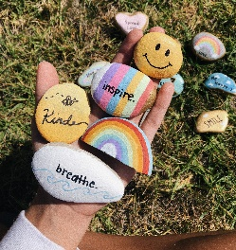
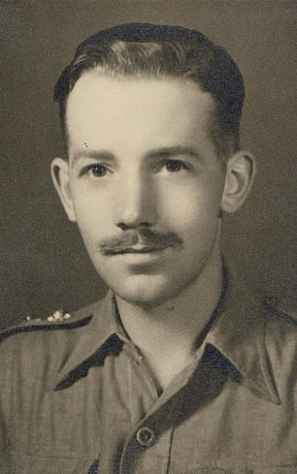
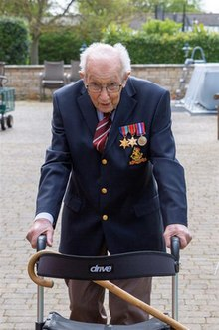
Positive messages
of the week
Hello again,
Weeks are passing by so quickly. With lots of different things happening around the world.
We still enjoy seeing all your rainbows.
Captain Tom Moore celebrated his 100th birthday.
We continue to clap for our NHS on a Thursday.
Young children are putting out painted cobbles whilst out exercising.
Here we see Capt. Tom Moore probably at the beginning of his Military carer
And after a life time of hard work and taking care of all around him. Here we see Tom Our Hero

Slide 3
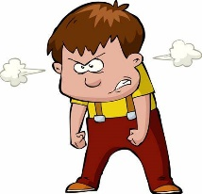
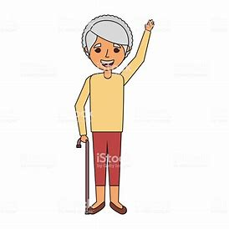
PCSO Mandy Says hi
Please don’t accept friend requests online from people you don’t know!
Report nasty messages!
Tell grown ups if somebody has asked you to do something where you felt uncomfortable!
Never post pictures on public sites!

Slide 4
Police messages
You are all doing great at keeping safe!
What else can you do?
Help out with chores at home.
Listen to your parent/s or whoever looks after you.
Keep up the good homework.
Limit your screen time and keep safe.
Take some kind of exercise.

Slide 5
If it is your Birthday this week Happy Birthday
Happy Birthday to you, Happy Birthday to you, Happy Birthday Special person Happy Birthday toooo yoooou

Slide 6
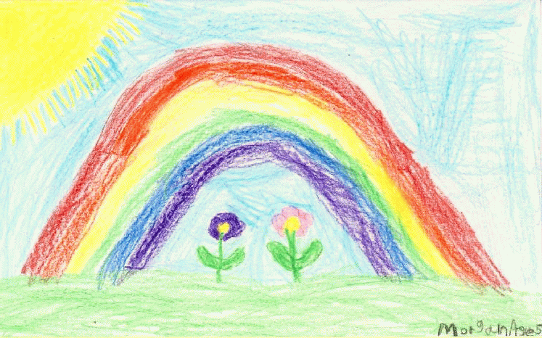
Activities
Leave a nice comment on a friends post.
Say HEY to a friend you haven’t spoken to in a while.
Share a positive post or a nice sticker.
Riddle: I am full of holes, I can hold water, what am I?
Answers on last slide, no peeking until you’ve had a go at this!
Riddle: how do bees get to school? Answer: on last slide, no peeking until you’ve had a go at this!
Riddle: What’s really easy to get into, and hard to get out of?
Answers on last slide, no peeking until you’ve had a go at this!

Slide 7
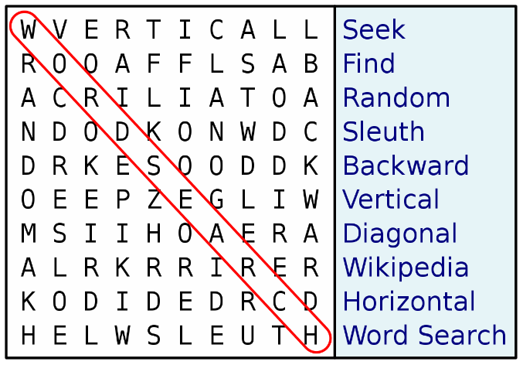
And now for the detectives out there!
“Find it”
Look around your home and again when you are out doing some exercise to see if you can find these items.
Rules – Don’t collect or move living things, leave them alone. And don’t touch yucky or smelly things.
Something smelly
Something furry
Something crunchy
Something light
Something heavy
Something spotty
Something yucky
Something wet
Something round
Something stripy

Slide 9
Until next Time
19th MAY 2020
Keep washing your hands and carry on with your exercise.
Stay healthy, by doing a bit of exercise every day.
Keep positive, by reminding yourself, You are an Amazing Child.
And remember we won’t be indoors forever
Childline | Childline
https://www.childline.org.uk
Get help and advice about a wide range of issues, call us on 0800 1111, talk to a counsellor online, send Childline an email or post on the message boards

Slide 10
Answers to Riddles Riddle: What’s really easy to get in to, and hard to get out of? Answer: Trouble Riddle: I am full of holes, I can hold water, what am I? Answer: Sponge Riddle: how do bees get to school? Answer: School Buzz

