Slide 1
Whilst You Are At Home
We are going to stay in touch
2nd April 2020

Slide 2
Positive Message of the Week
Hello everyone, because we cannot visit you in your schools at the moment, we will now be sending out weekly messages. Each week we will be adding new activity ideas for you to do at home either by yourself, a family member or your personal friends online.
We are aware all the changes going on at the moment might make you feel scared or worried. That’s OK. It’s totally normal to feel like this. We all need to remember this situation won’t last forever.
Please remember Cheshire Police PCSO’s are out and about on your streets from before you get up in the morning to after you go to bed, to make sure you are safe when you come out to get some exercise.

Slide 3
Police messages
Regarding Online safety
You are all smart children and we want you to remember the Online Safety messages.

Slide 4
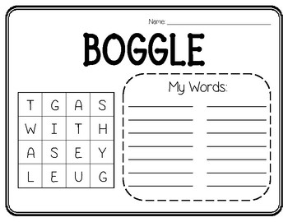
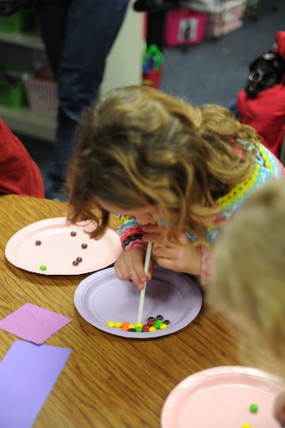
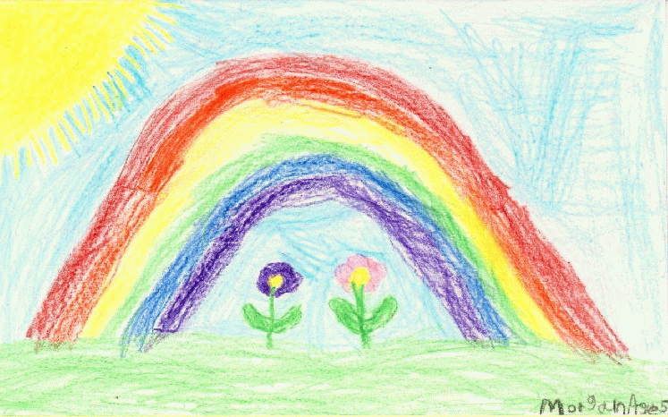
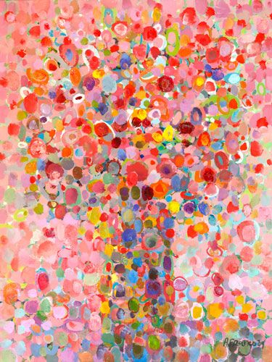
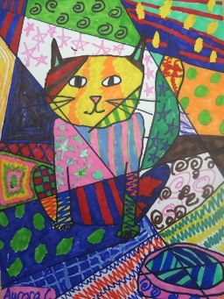
Activities
“Riddle: There is a rooster sitting on top of a barn. If it laid an egg, which way would it roll?”
Answers on last slide, no peeking until you’ve had a go at this!
Create a picture or Piece of Art that can be sent to family members and maybe placed in your windows to be shared with everyone.
Riddle: I am an odd number. Take away a letter and I become even. What number am I?”
Answers on last slide, no peeking until you’ve had a go at this!

Slide 5
Until next Time
14th April 2020
Stay safe, by Washing your Hands and stay at home until it’s time for some exercise.
Stay healthy, by doing a bit of exercise every day.
Keep positive, by reminding yourself, You are an Amazing Child.
And remember we won’t be indoors forever
Childline | Childline
https://www.childline.org.uk
Get help and advice about a wide range of issues, call us on 0800 1111, talk to a counsellor online, send Childline an email or post on the message boards

Slide 6
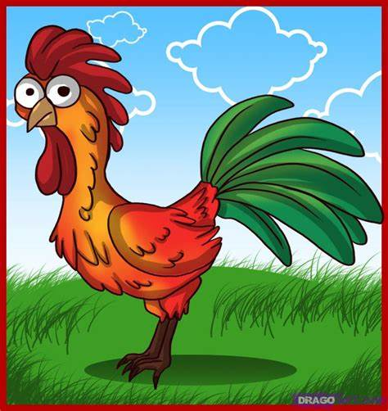
Answers to Riddles “Riddle: There is a rooster sitting on top of a barn. If it laid an egg, which way would it roll?” Answer: Roosters don’t lay eggs. Riddle: I am an odd number. Take away a letter and I become even. What number am I?” Answer: Seven.

