Slide 1
Geography
The Amazing Americas
Year One
Geography | Year 6 | The Amazing Americas | Location, Location | Lesson 2

Slide 3
Aim
I can use geographical terminology to describe the location of a range of places across the Americas.
Success Criteria
I can explain the meaning of key vocabulary relating to geographical location.
I can explain how latitude affects the physical features of a geographical region.
I can use maps and atlases to locate countries and regions of the Americas.
I can tell you the geographical location and key characteristics of different places across the Americas.

Slide 4
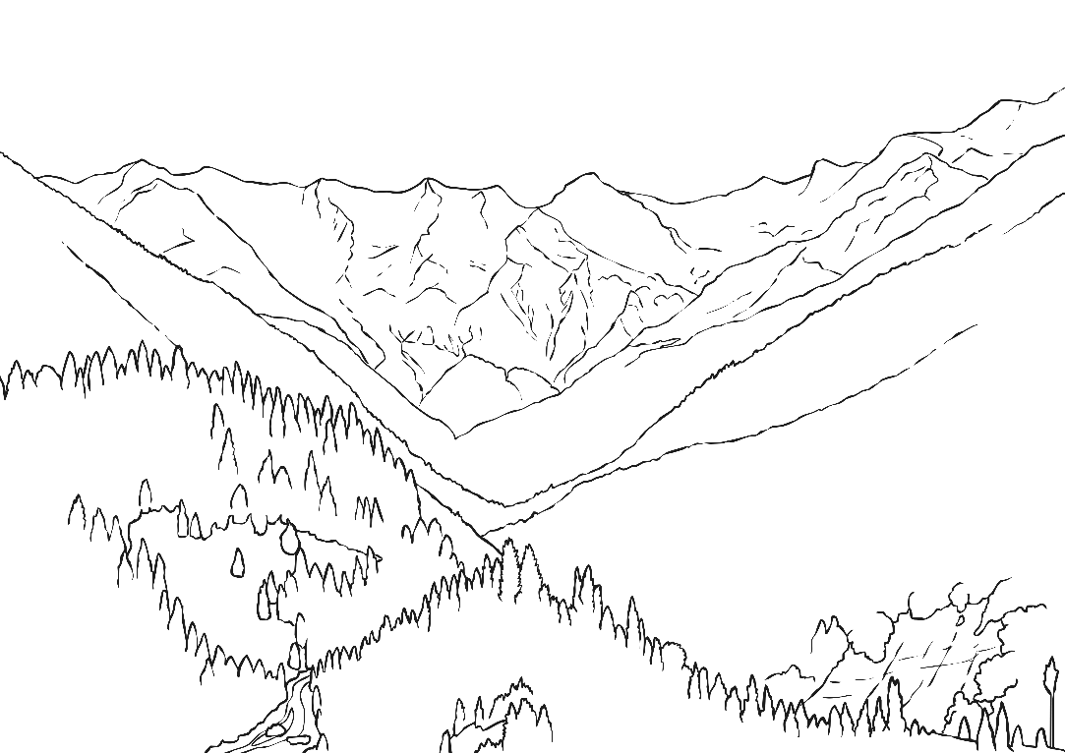
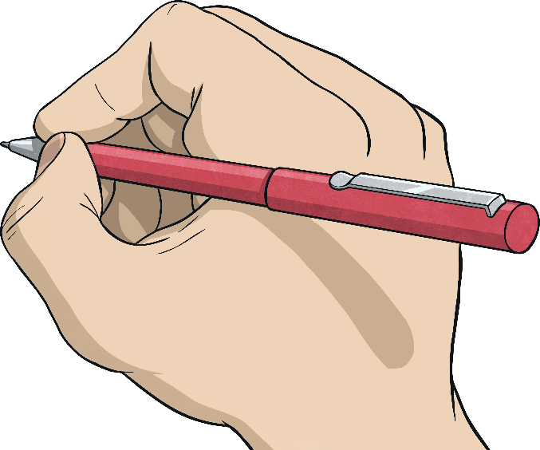
What Do You Think It Looks Like?
How are the places similar?
Divide your paper into two.
How are they different?
On one half, draw or write about a place in North America.
On the other half, draw or write about a place in South America.
Share your ideas with a partner.

Slide 5
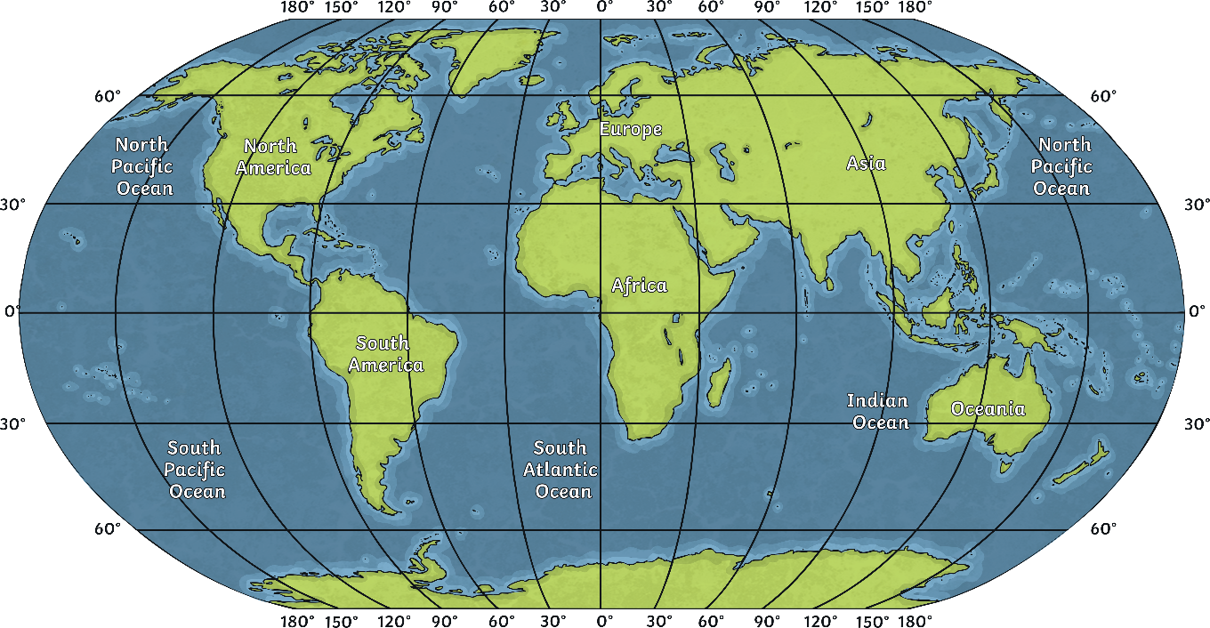
Latitude and Longitude
This world map shows the lines of latitude and longitude.
What do the lines of latitude and longitude tell us?
Arctic Circle
Tropic of Cancer
Equator
Tropic of Capricorn
Antarctic Circle
Which lines of latitude and longitude do North and South America cross?
Will the places in each land mass look the same? Why/Why not?
(You can revise latitude and longitude here.)

Slide 6
Climate Zones
What are the features of the different climate zones?
What impact does the climate zone have on a place?
What do you know about these areas?
Click each of the areas to find out more.
Arctic Circle
Tropic of Cancer
Equator
Tropic of Capricorn
Close
Close
Close
Close
Close
Antarctic Circle: An imaginary line around the southernmost part of the Earth. Circles the South Pole.
Arctic Circle: An imaginary line around the northernmost part of the Earth. Circles the North Pole.
Tropic of Capricorn: An imaginary line around the globe at latitude 24° south. The sun is directly above this line at the solstice around 21st December.
Equator: An imaginary line around the globe at latitude 0° north. The sun is directly above this line around 20th March and 23rd September
Tropic of Cancer: an imaginary line around the globe at latitude 24° north. The sun is directly above this line at the solstice around 21st June.
Antarctic Circle
1
2
3
4
5

Slide 7
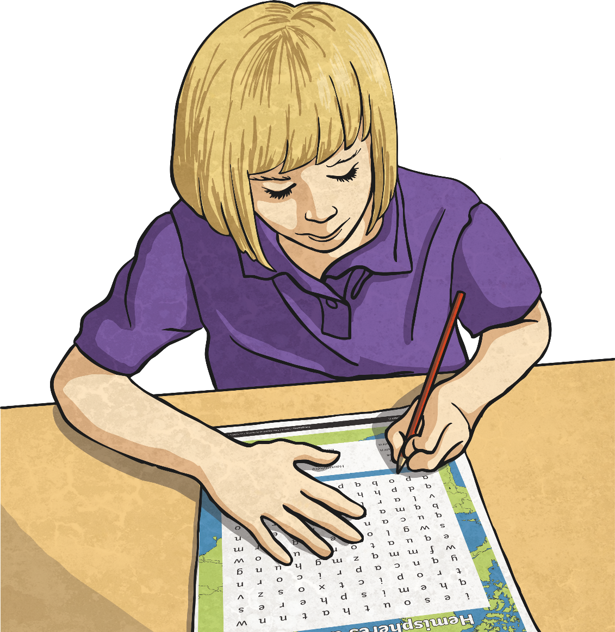
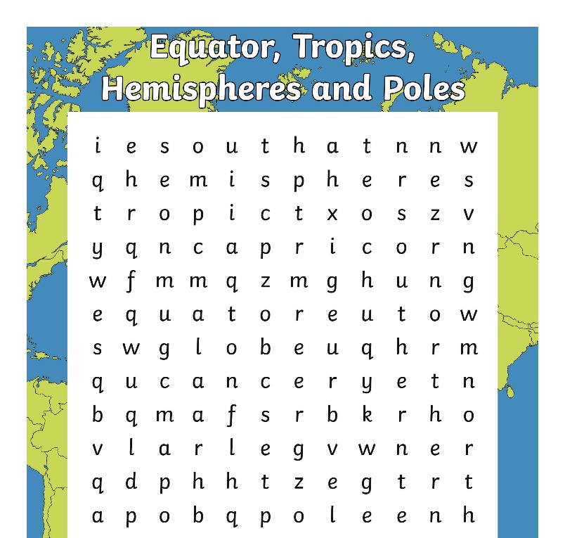
Key Vocabulary
Work with a partner to complete the Word Search Activity Sheet. Then write a definition of each of the key words found.

Slide 8
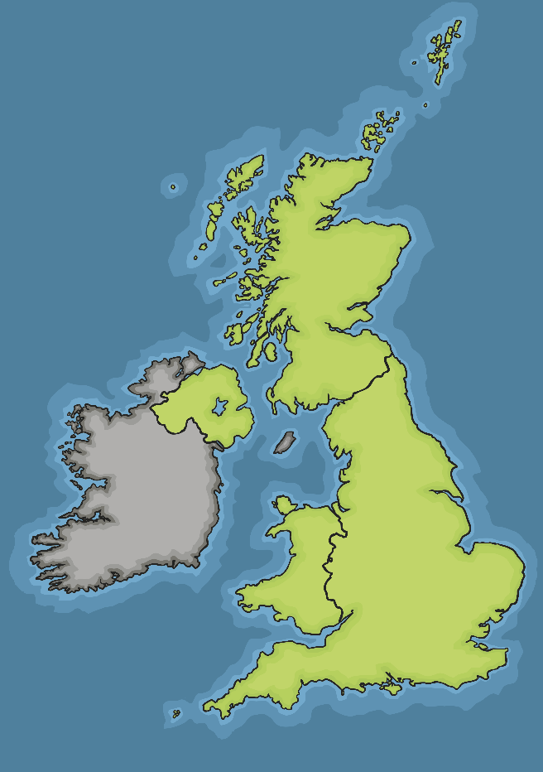
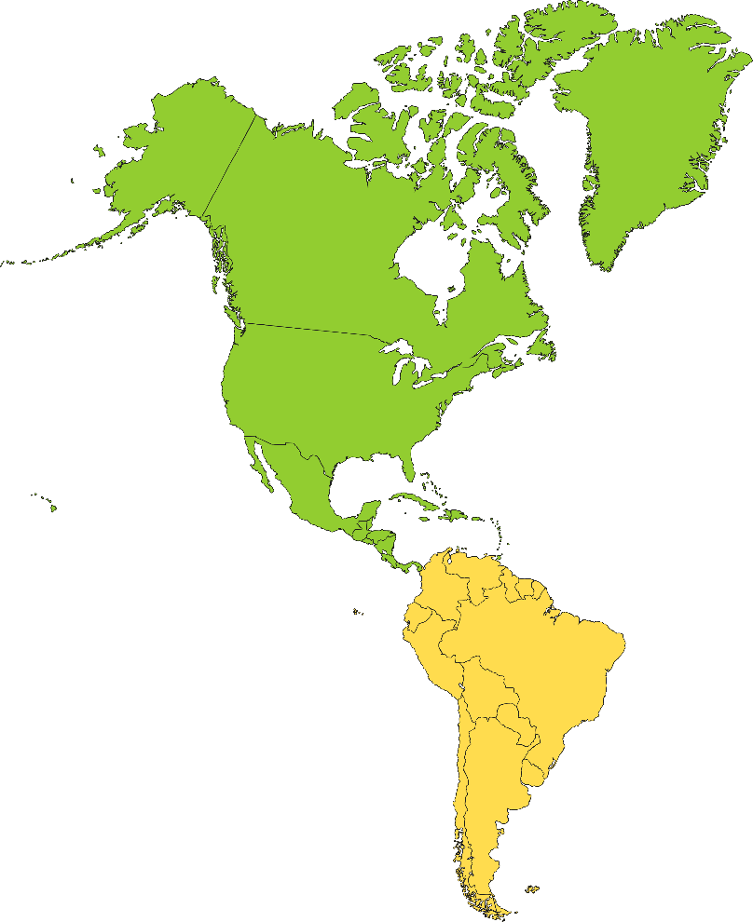
Geographical Locations and Characteristics
Unlike the United Kingdom, the Americas cover a huge area of the globe, extending over several lines of latitude and longitude. This means that the characteristics of different countries and regions vary significantly. These will include temperature, rainfall, vegetation and land use.
Use maps, atlases, information books and the internet to help you complete the Geographical Locations and Characteristics Activity Sheet.

Slide 9
Making Comparisons
How are they similar?
How are the places you have studied different to the UK?
Where would you prefer to live?

Slide 10
Aim
I can use geographical terminology to describe the location of a range of places across the Americas.
Success Criteria
I can explain the meaning of key vocabulary relating to geographical location.
I can explain how latitude affects the physical features of a geographical region.
I can use maps and atlases to locate countries and regions of the Americas.
I can tell you the geographical location and key characteristics of different places across the Americas.

