Slide 1
Whilst you are at home Edition 4
28th April 2020

Slide 2
Positive message of the week….
Hello again, we are all sending you an ‘elbow bump’
We are now on our fourth weekly message. Hands up who is enjoying our weekly inputs?
I have enjoyed seeing all your rainbows in your windows.
PC Panda says...........
‘I hear from your teachers and parents that you are all doing amazing in keeping safe! I am so pleased to hear this and we can’t wait to see you all again’

Slide 3
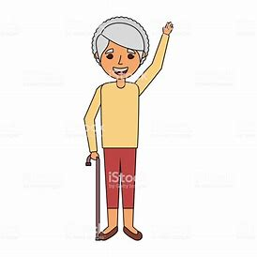
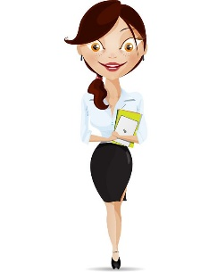
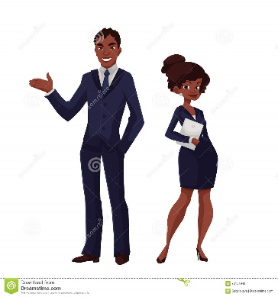
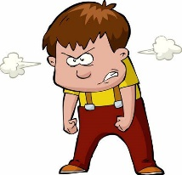
PCSO Penny says Hi ☺
Please don’t accept friend requests online from people you don’t know!
Remember to not talk to strangers!
Always use your seatbelt on your essential journeys and do not distract the driver!
Before crossing a road, make sure you check both ways ☺

Slide 4
Police messages
You are all doing smashing at keeping safe! What else do you need to remember?
Help out with chores at home. A tidy home is a happy home ☺
Listen to your parent/s, it is respectful
Keep up the good homework, you will be so smart
Limit your screen time. Being outdoors is good for your brain too

Slide 5
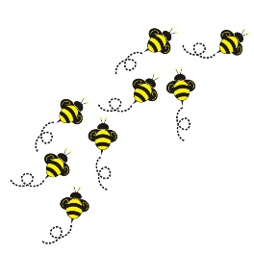
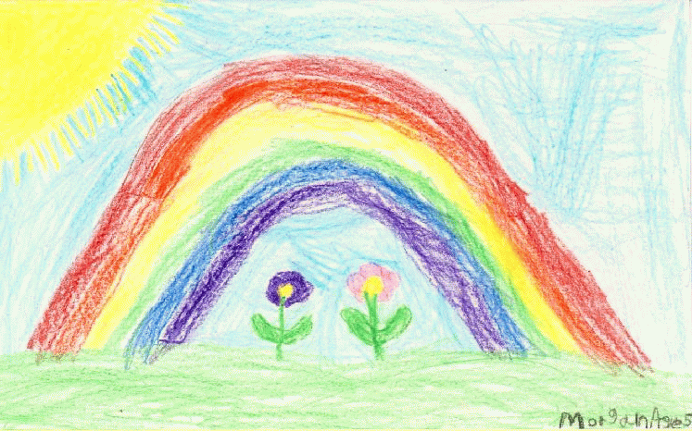
Activities
This weeks project
Organise your own sports day!
This can be indoors or outdoors depending on the weather.
Set up your own mini racetrack, have an egg and spoon race or use cushions for hurdles! Have fun!
Riddle: Which letter of the alphabet has the most water?
Answers on last slide, no peeking until you’ve had a go at this!
“Riddle: What has a face and two hands but no arms or legs?”
Answers on last slide, no peeking until you’ve had a go at this!

Slide 6
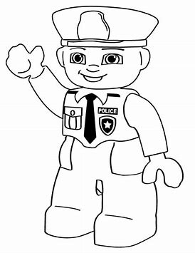
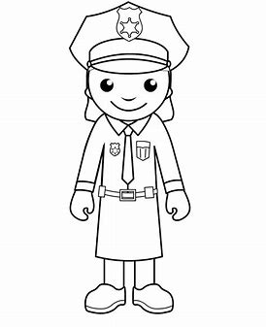
Colouring fun

Slide 7
Until next Time
5th MAY 2020
Stay safe, by Washing your Hands and stay at home until it’s time for some exercise.
Stay healthy, by doing a bit of exercise every day.
Keep positive, by reminding yourself, You are an Amazing Child.
And remember we won’t be indoors forever
Childline | Childline
https://www.childline.org.uk
Get help and advice about a wide range of issues, call us on 0800 1111, talk to a counsellor online, send Childline an email or post on the message boards

Slide 8
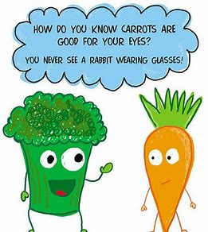
Answers to Riddles Riddle: What has a face and two hands but no arms or legs? Answer: A clock Riddle: Which letter of the alphabet has the most water? Answer: C
How do bees get to school?
On the school buzz!
Why did Gran put wheels on her rocking chair?
So she could rock n roll!
Why do ducks make good detectives?
They always quack the case!

