Slide 1
Science
Properties and Changes of Materials
Year One
Science | Year 5 | Properties and Changes of Materials | Properties of Materials| Lesson 1

Slide 2
Properties of
Materials

Slide 3
Aim
I can compare materials according to their properties.
Success Criteria
I can describe a material’s properties.
I can explain the uses of different materials based on their properties.
I can sort and compare materials according to their properties.

Slide 4
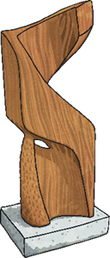
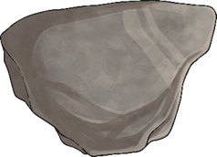
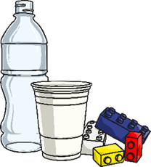
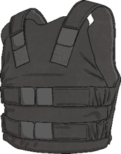
Describing Materials
Any substance that is used to make something is a material.
Natural materials such as stone, wood and cotton are used or worked with in the way they are found in nature.
Synthetic or man-made materials are made from natural materials, but are altered with the help of heat or chemicals. Some examples include plastics, polyester and Kevlar.
Natural
Man-made

Slide 5
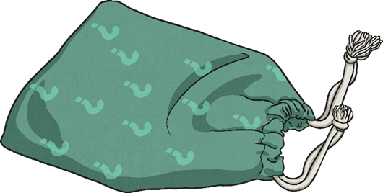
Describing Materials
Around your classroom you will see
several feely bags.
In each bag is a material. Can you
identify the different materials just
by feeling them?
While you have a go at this activity, think of words to describe each material, such as hard, soft, cold or rough.

Slide 6
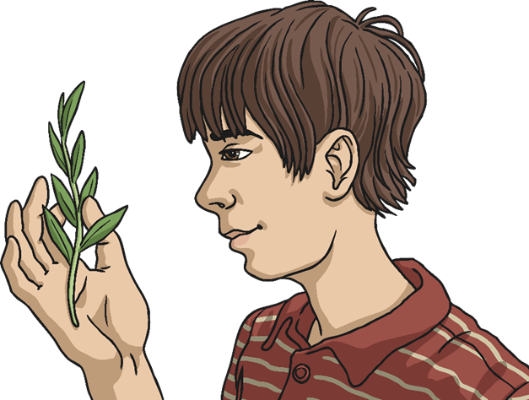
Describing Materials
Have a look inside the feely bags.
Were you right about any of the materials?
What words did you think of to describe each material?

Slide 7
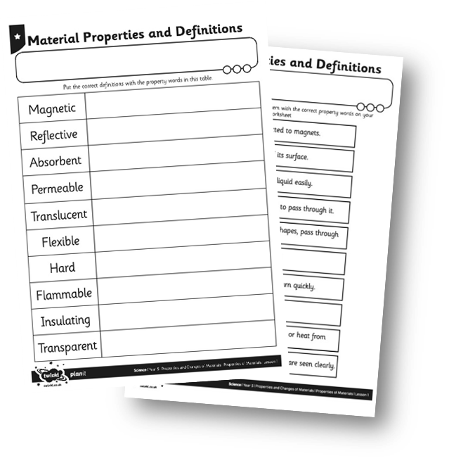
Properties
The words used to describe a material are known as its properties.
Each material has its own set of properties.
These properties make different materials useful for different purposes.
Can you match the properties with their definitions on your Material Properties Activity Sheet?

Slide 8
Using Materials
Why is it useful to know the properties of a material?
It is useful because if you know the properties of a material, you can then choose the best material for a purpose.
Look again at the objects from the feely bags. Why was each material chosen to make these things?
Talk to your partner
about your ideas.

Slide 9
Testing Properties
To find out which properties a material has, they have to be tested.
You are going to test several different materials to find their properties.
You will test for:
magnetism;
hardness;
transparency;
flexibility;
permeability.

Slide 10
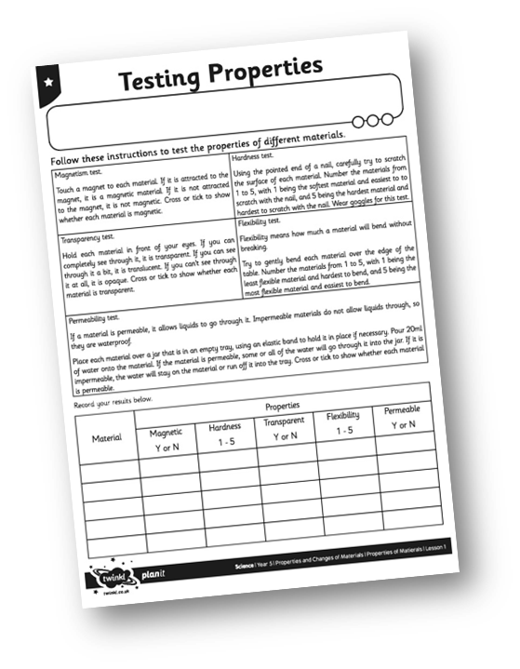
Testing Properties
Follow the instructions for each test, and try out each test with each material.
Complete your Testing Properties Activity Sheet with your results.

