Slide 1


Slide 2
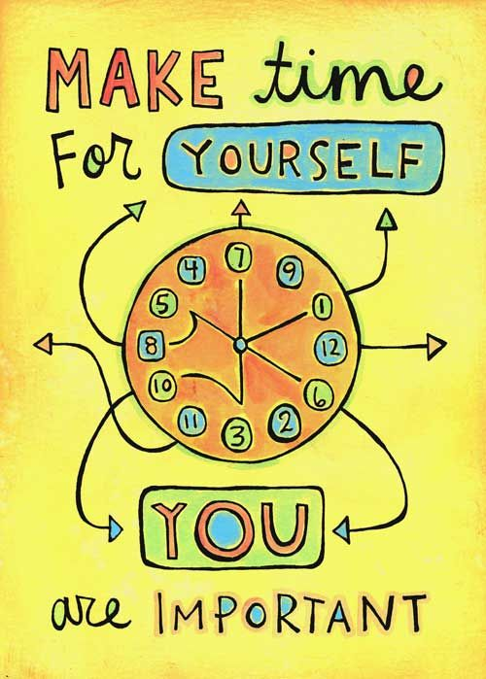
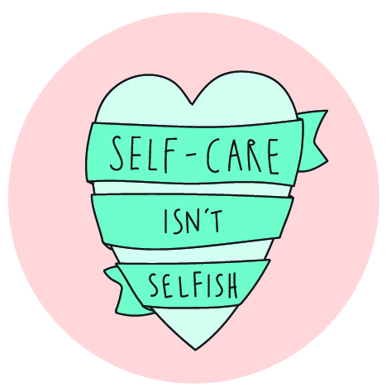
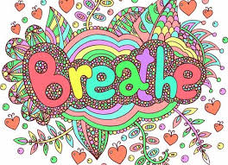

Slide 3
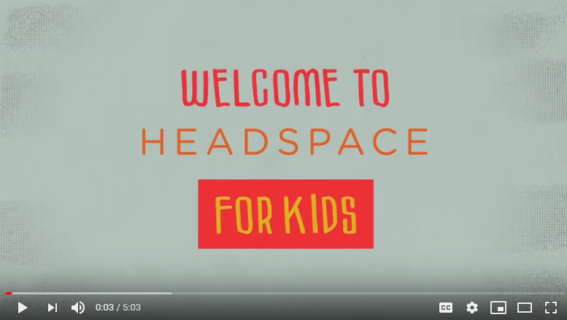
https://www.youtube.com/watch?v=W21KjnF3YME&safe=true

Slide 4
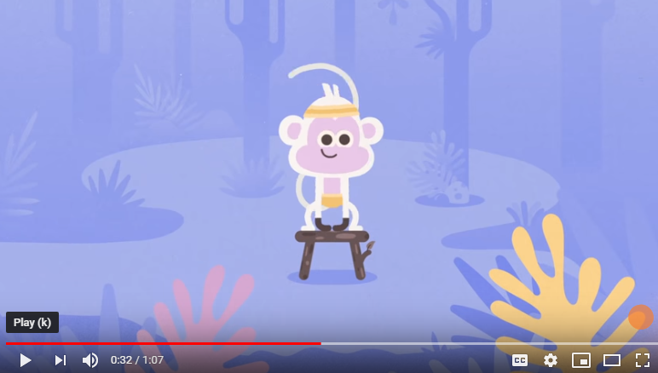
https://www.youtube.com/watch?v=qxyVCjp48S4&safe=true

Slide 5
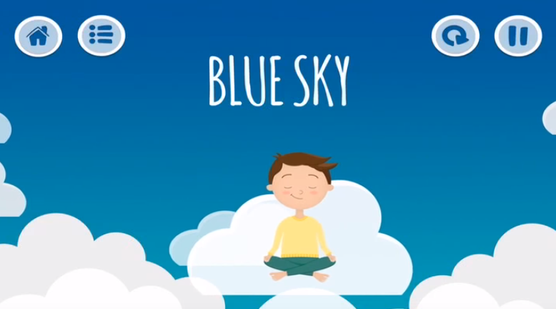
https://www.youtube.com/watch?v=5qoU_XBkm3g&safe=true

Slide 6
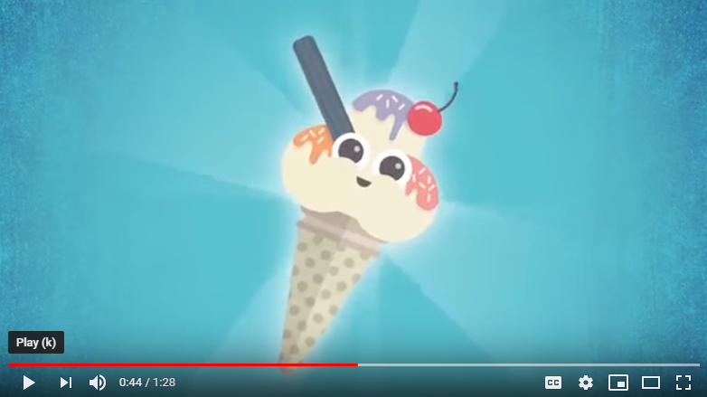
https://www.youtube.com/watch?v=nroyrDRXkFg&safe=true

Slide 7
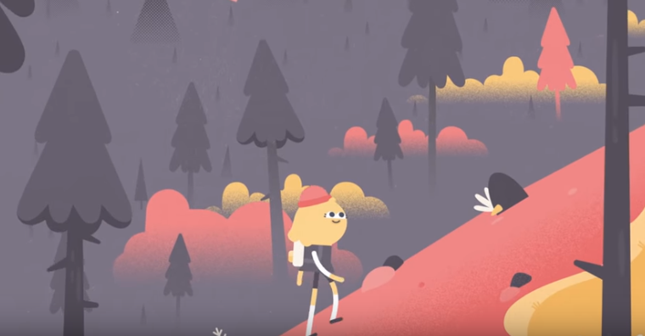
https://www.youtube.com/watch?v=F0WYFXxhPGY&safe=true

Slide 8
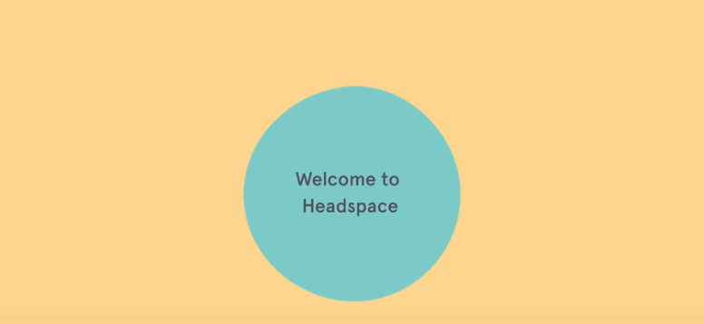
https://www.youtube.com/watch?v=c1Ndym-IsQg&safe=true

Slide 9
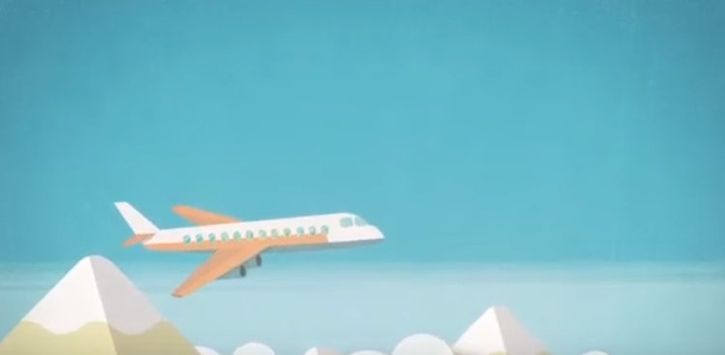
https://www.youtube.com/watch?v=kmvVwD4_KYo&safe=true

Slide 10
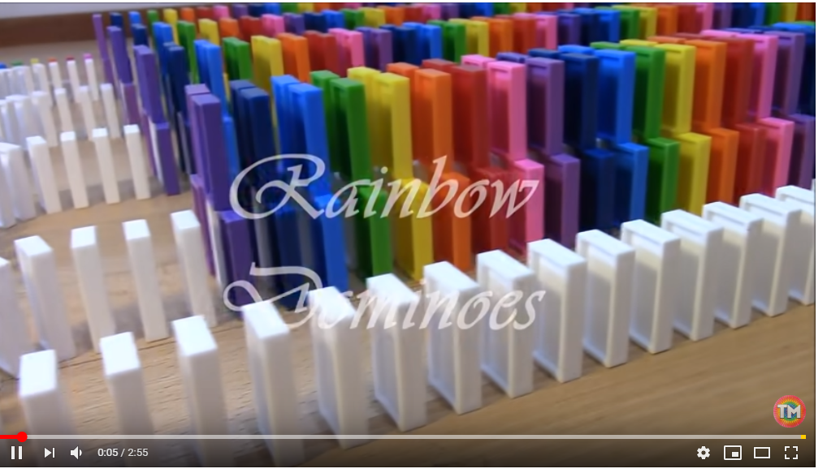
Watch this to feel satisfied!
Follow the dominoes with your eyes.
https://www.youtube.com/watch?v=n9vHtXpygfE&safe=true

Slide 11
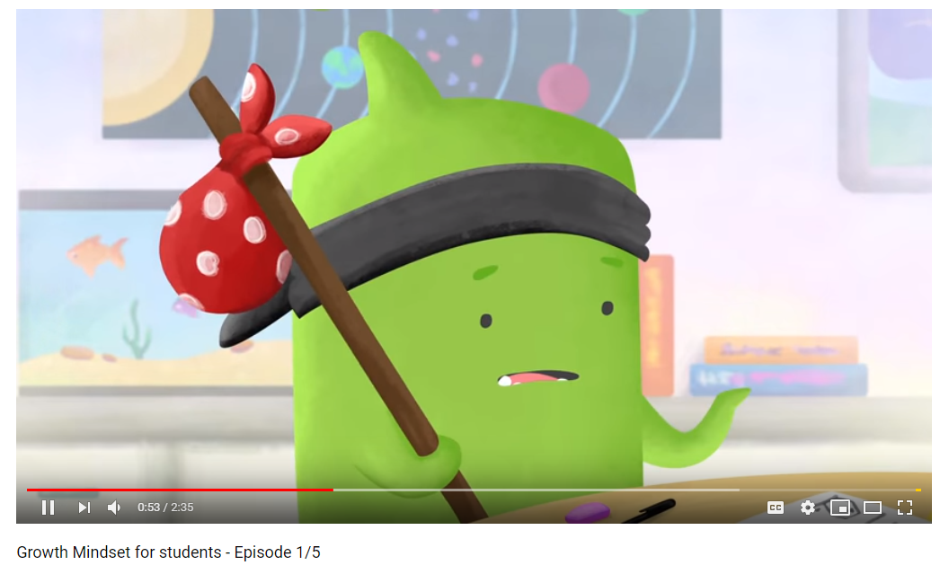
Growth Mindset
Dojo- Episode 1
https://www.youtube.com/watch?v=2zrtHt3bBmQ&safe=true

Slide 12
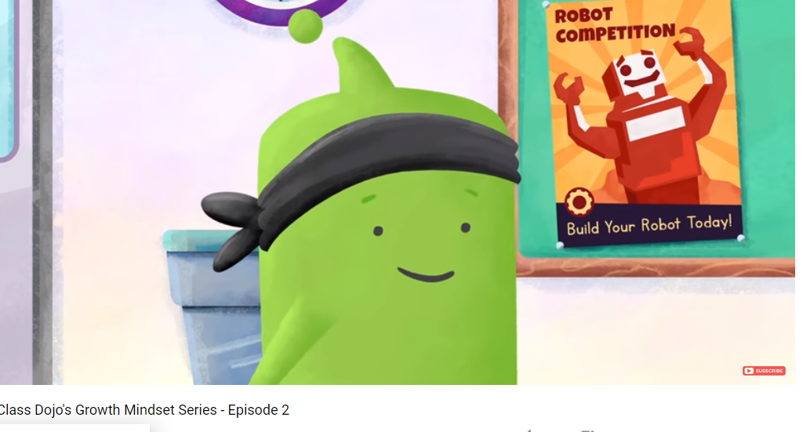
Growth Mindset
Dojo- Episode 2
https://www.youtube.com/watch?v=EoWLgWCcpWo&safe=true

Slide 13
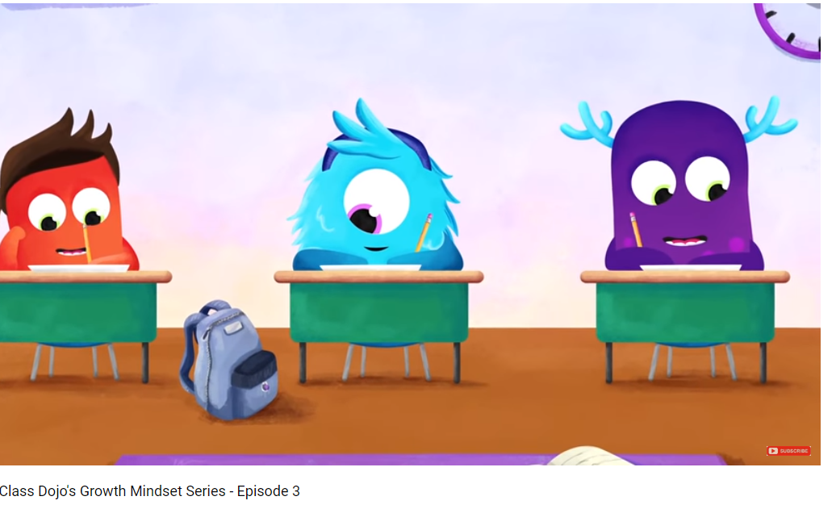
Growth Mindset
Dojo- Episode 3
https://www.youtube.com/watch?v=OFKVoCuwl2s&safe=true

Slide 14
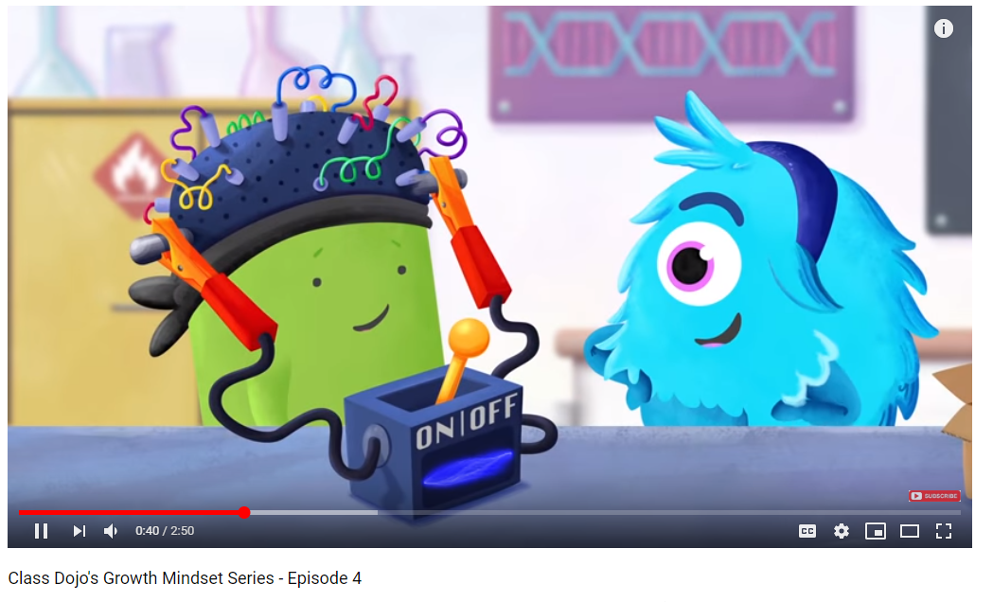
Growth Mindset
Dojo- Episode 4
https://www.youtube.com/watch?v=HWr2gE5IlPc&safe=true

Slide 15
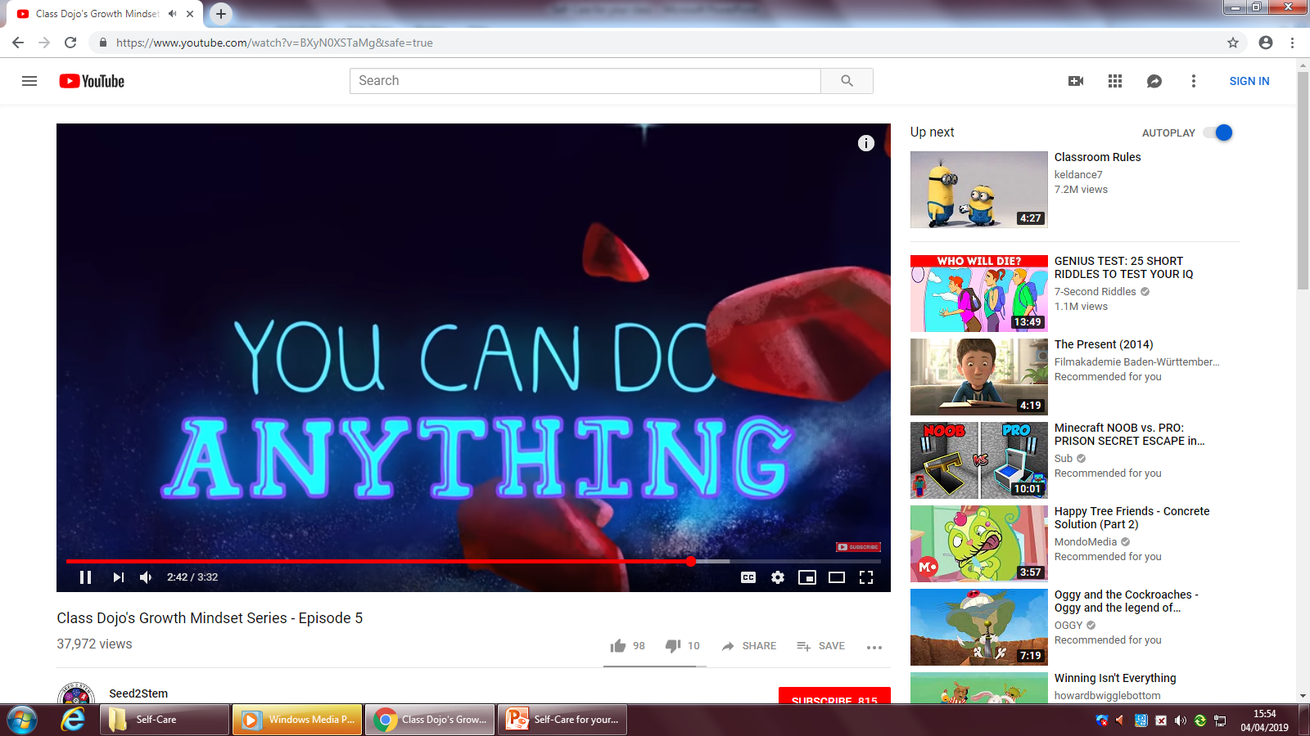
Growth Mindset
Dojo- Episode 5
https://www.youtube.com/watch?v=BXyN0XSTaMg&safe=true

Slide 16
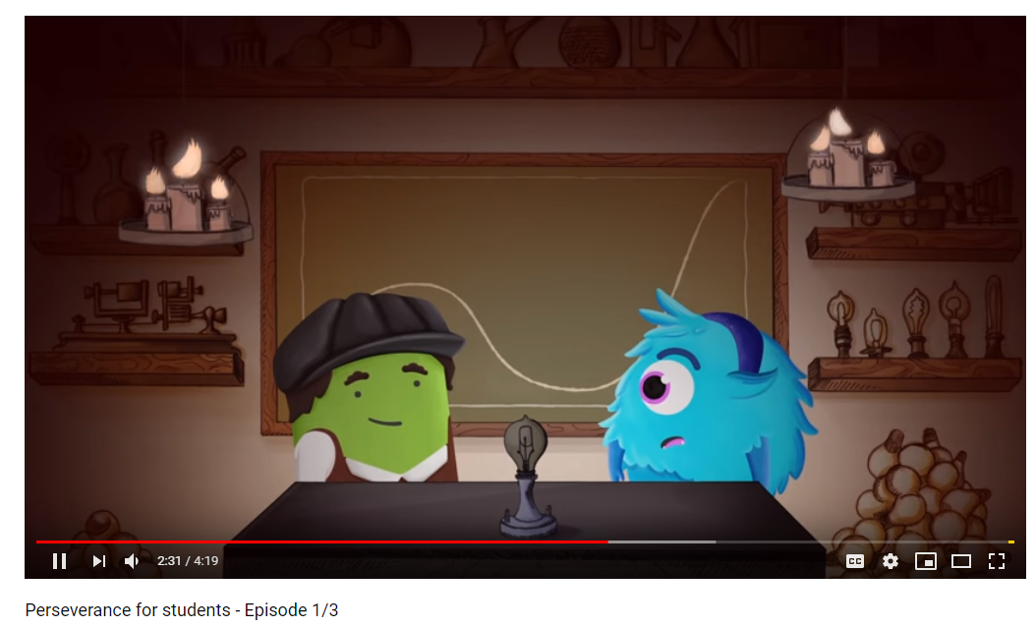
Perseverance
Episode 1
https://www.youtube.com/watch?v=IOaFwwLyTRo&safe=true

Slide 17
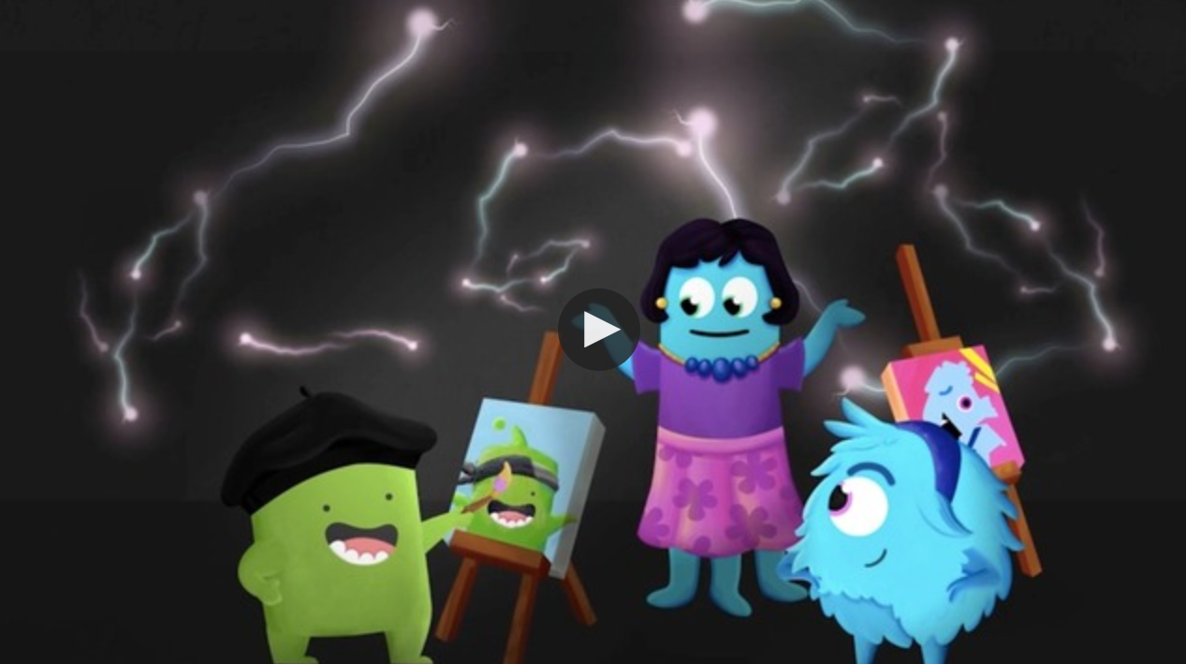
Perseverance
Episode 2
N.B. click Try this, if the video is not working or you want to access without logging in.

Slide 18
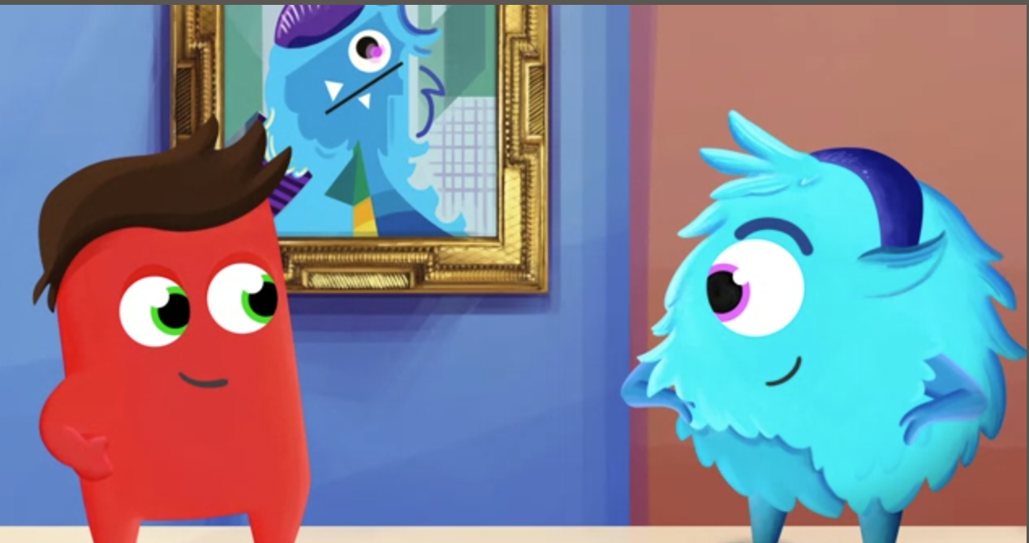
Perseverance
Episode 3
https://ideas.classdojo.com/i/perseverance-the-dip-3
N.B. click Try this, if the video is not working or you want to access without logging in.

Slide 19
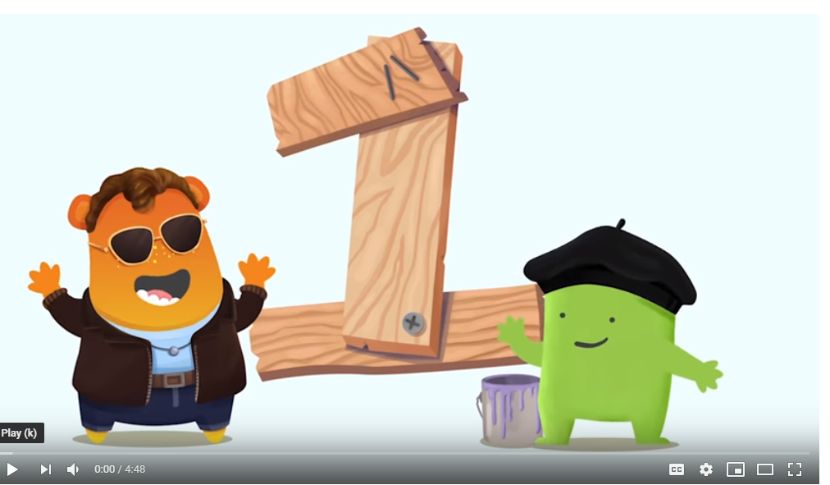
Empathy
Episode 1
https://www.youtube.com/watch?v=ENIB2H3S_oQ&safe=true

Slide 20
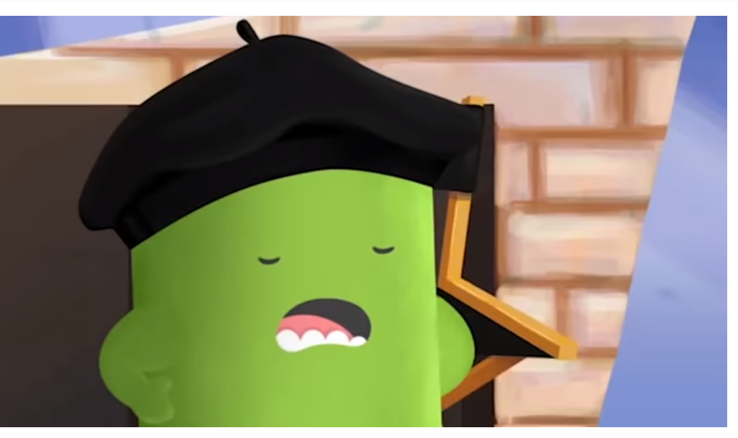
Empathy
Episode 2
https://www.youtube.com/watch?v=H6WNRMj4970&safe=true

Slide 21
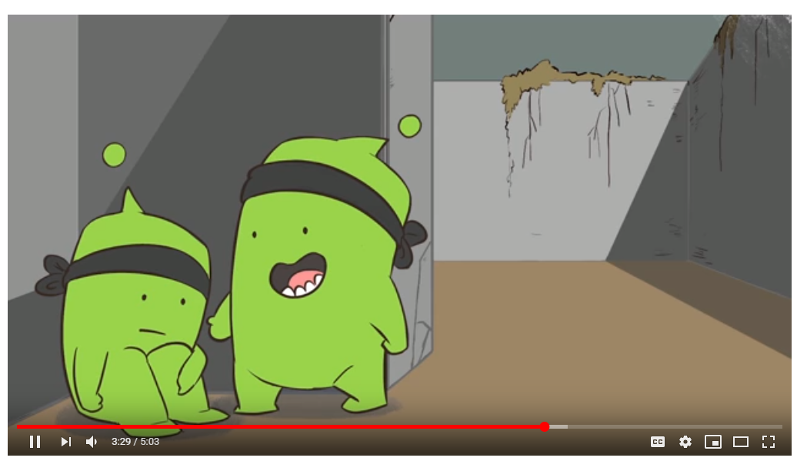
Empathy
Episode 3
https://www.youtube.com/watch?v=rRjYgfFnrL4&safe=true

Slide 22
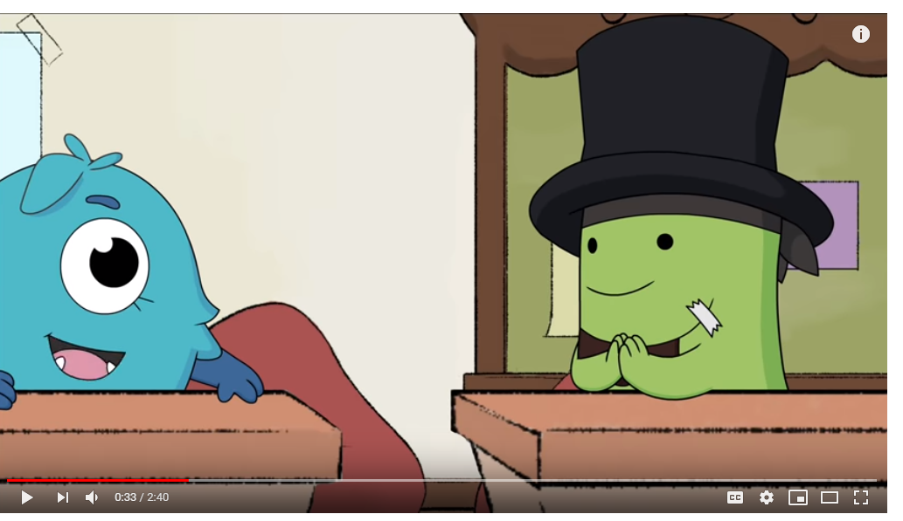
Mindfulness Activity/
Question
https://www.youtube.com/watch?v=r6CPzyqCff0&safe=true

Slide 23
Smile!
Write down 5 things that
have made you smile today
(no matter how small!)

Slide 24
Happy!
Write down as many
things that make you happy
as you can in 2 minutes. Go!
(no matter how small!)

Slide 25
Gratitude!
Write down 10 things that
you are grateful for
(no matter how small!)

Slide 27
Be proud!
What have you achieved so far that you’re proud of?
Write down all of the wonderful things you’ve done in your life. Your list might include specific achievements, experiences, places you’ve been, and people you’ve met.
This list will remind you of the proud moments, so that you are excited for the future.

Slide 28
Connections
Describe one good thing that happened today.
Name three things you have in common with your partner.
What are some ways students at our school could help promote mental health and wellbeing?

Slide 29
5 things in common
Your task is to work as a group and identify five things that everyone in your group has in common.
These can be things to do with school, hobbies, family, pets etc.
Nominate one person in your group to write down the five things the group decides you all have in common.
When you have finished writing your list, choose a volunteer from your group to read out your list. See if anything overlaps across all group lists. There might be one thing that we all have in common.

Slide 30
5 good things
Instructions:
1. Explain to students that when we reflect on things that we’re grateful for, it can improve our general mood and wellbeing.
2. Ask students to take five minutes to think about and write down three things they are grateful for.
3. Each student should then share their three good things with five randomly selected students in the class.
4. Discuss as a group whether there were any similarities and differences between the students’ answers.

Slide 31
2 truths and 1 lie
1. Ensure that each student has a piece of paper and a writing tool.
2. Ask each student to write down three things about themselves. Two things need to be true, and one thing needs to be a lie. Students can write down anything – from a description of their appearance, to what foods or music they like, to places they have been.
3. Once everyone has written two facts and one lie about themselves, ask for volunteers to share their three things. When they have read out their list, the rest of the class should try to guess which thing is the lie.

Slide 32
Random acts of kindness
Instructions:
1. Explain to the students that they are going to think of and write down a random act of kindness they plan to do for another person. It may be for a classmate, or someone else at or outside of school. The act may be as simple as writing a letter thanking the person for doing something, helping someone with a project they are working on, paying someone a compliment, or inviting someone new to the school or neighbourhood to join in an activity.
2. Ask the students to write down the nature of their random act of kindness, who it will be aimed at, when they will complete the act, how they think completing it will make them feel, and what effect they expect it will have on the other person.
3. Ask the students to share their idea with a partner.

Slide 33
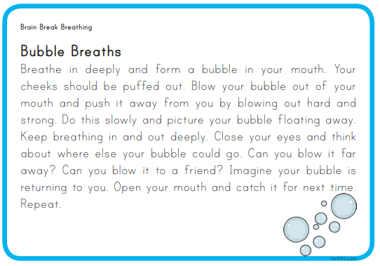

Slide 34
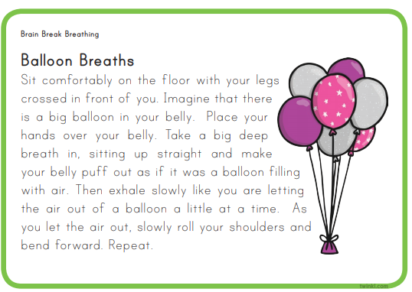

Slide 35
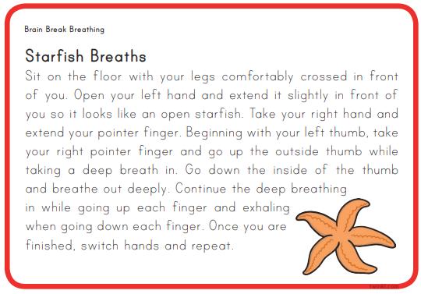

Slide 36
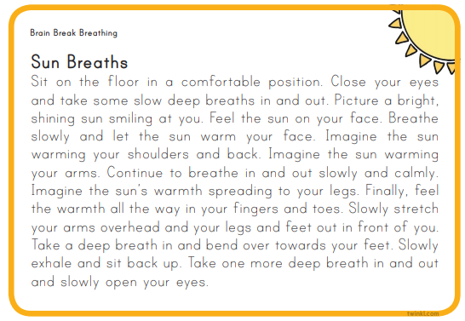

Slide 37
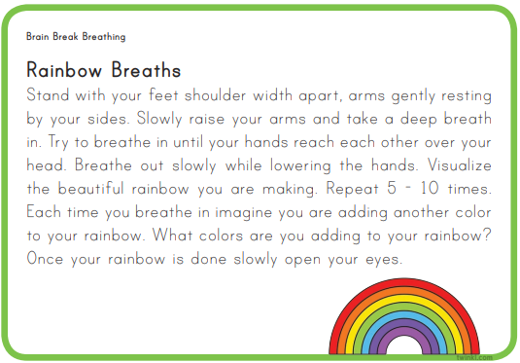

Slide 38
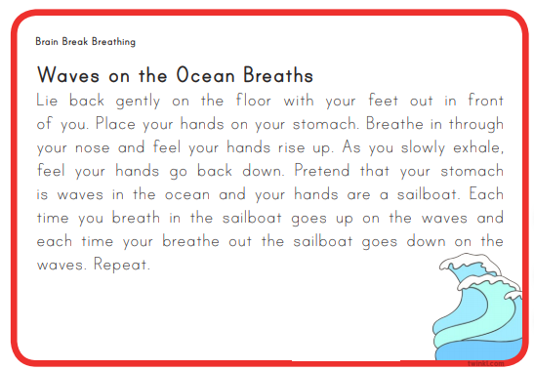

Slide 39
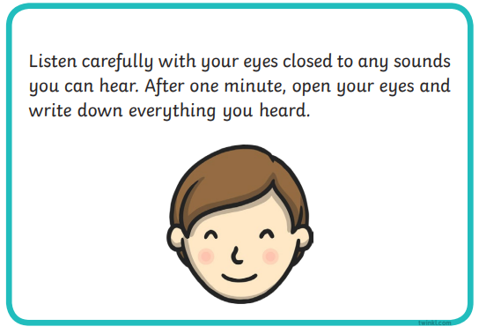

Slide 40
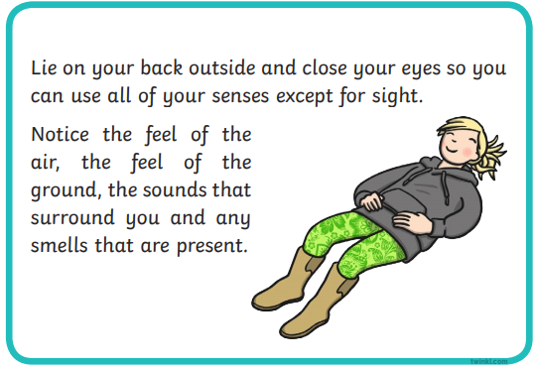

Slide 41
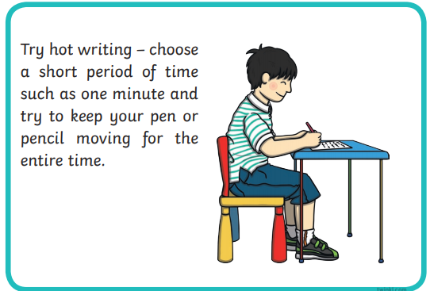

Slide 42
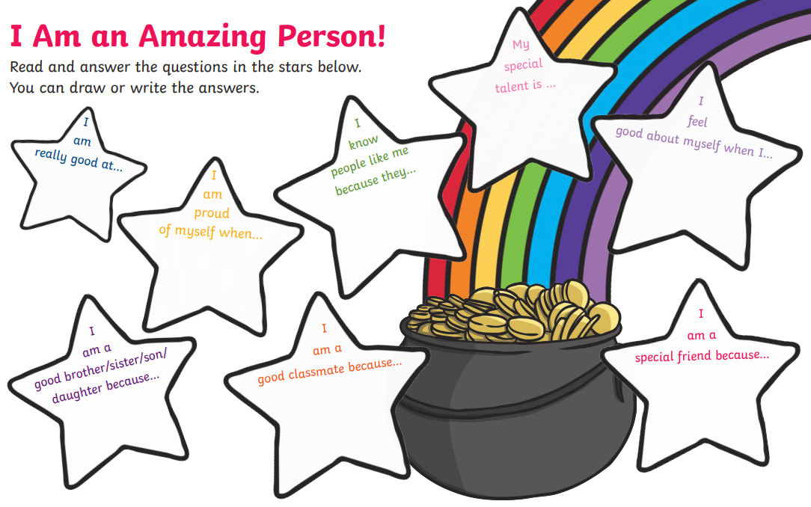

Slide 43
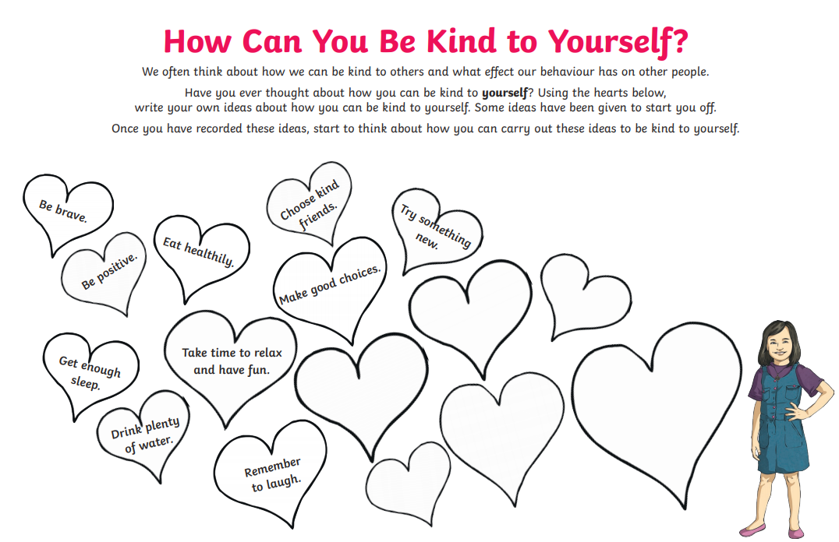

Slide 44
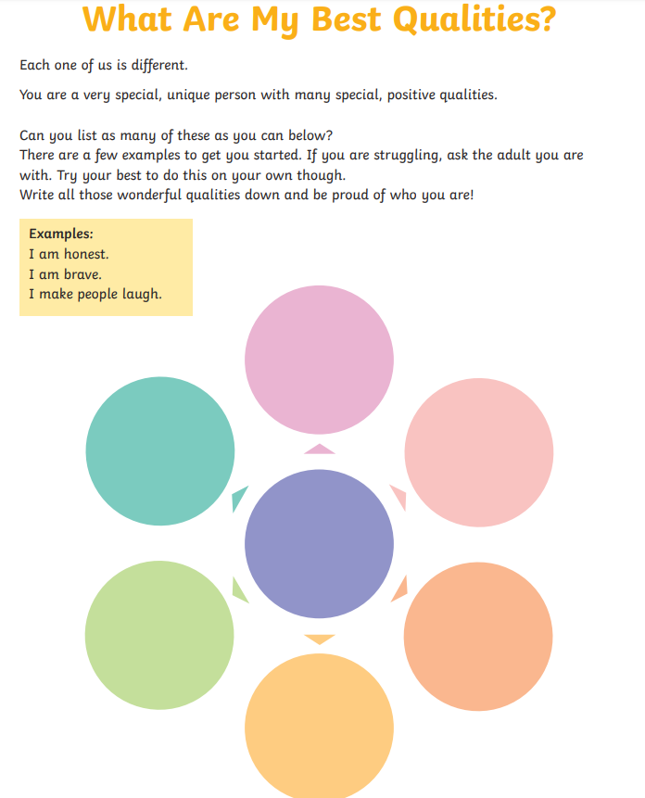

Slide 45
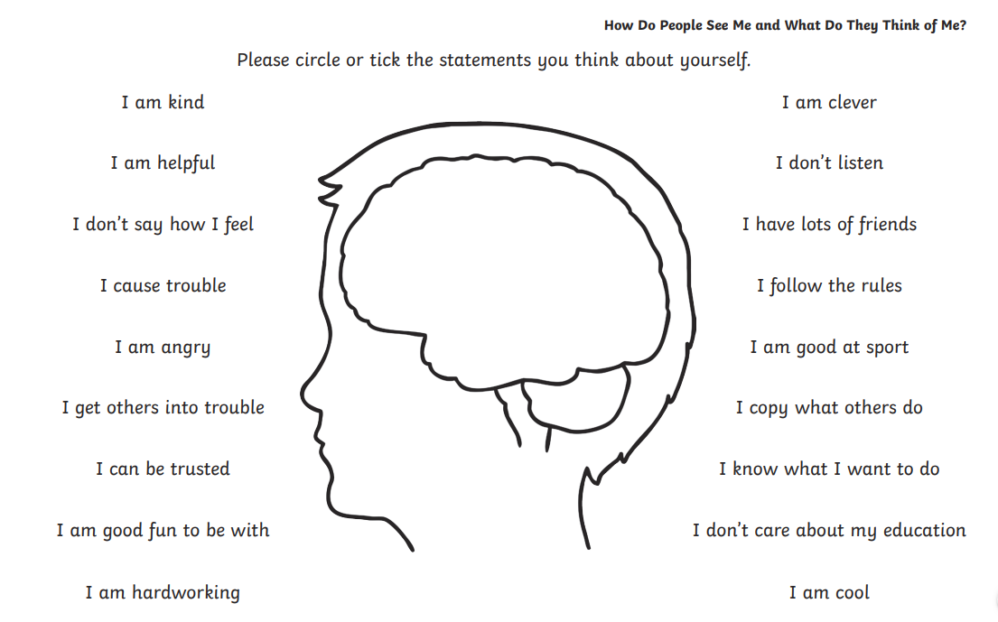

Slide 46
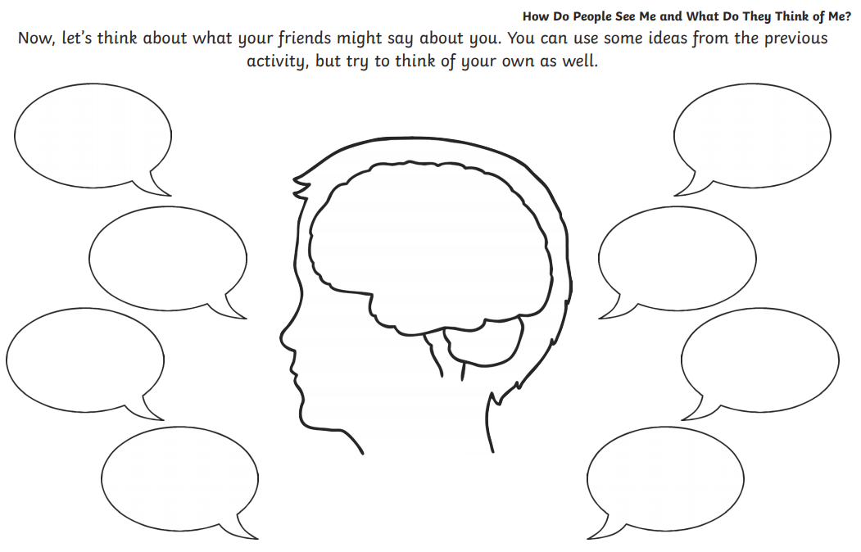

Slide 47
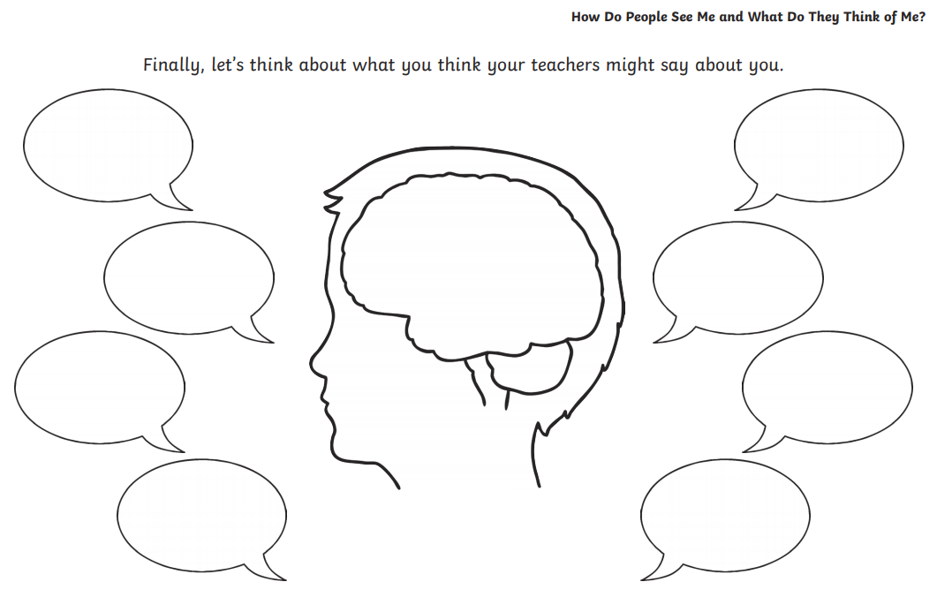

Slide 48
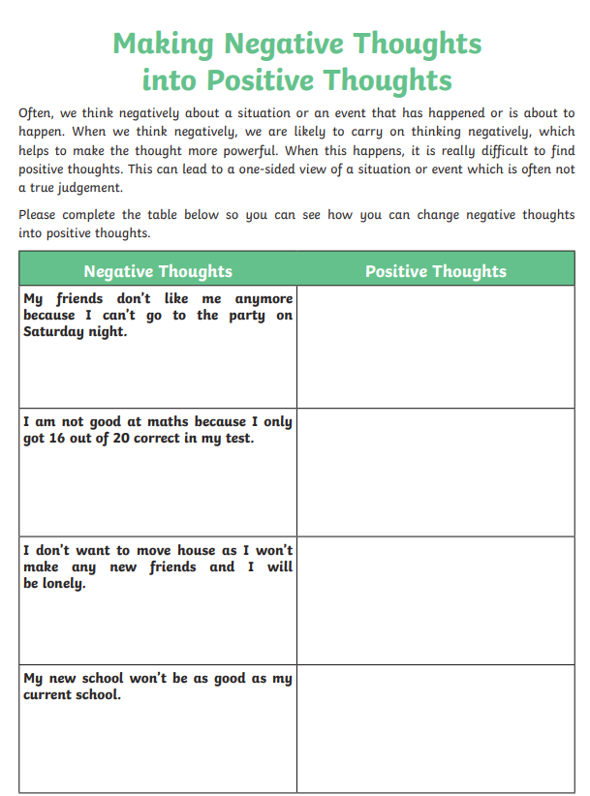

Slide 49
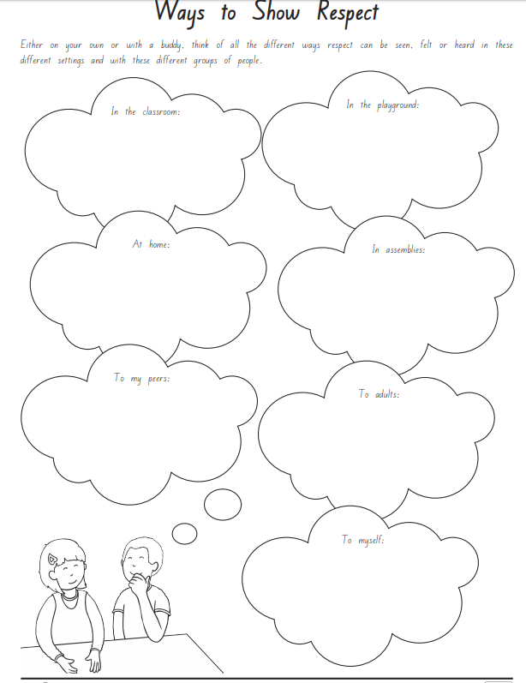

Slide 50
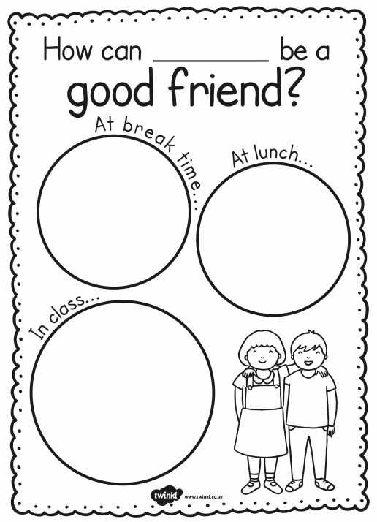

Slide 51
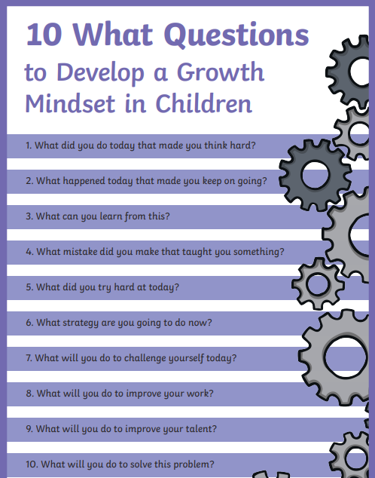

Slide 52
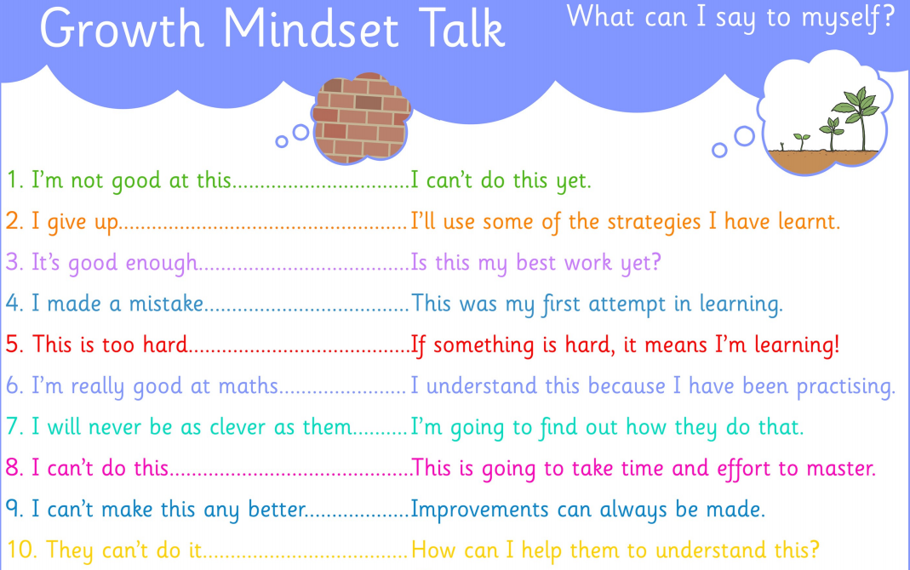

Slide 53
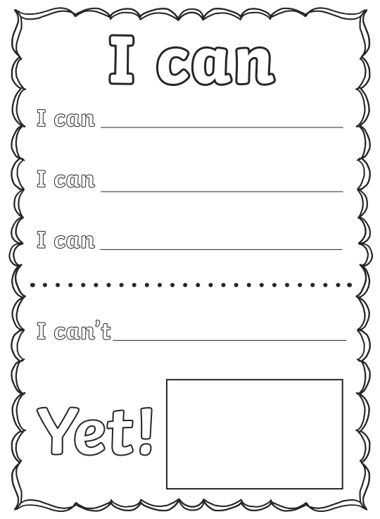

Slide 54
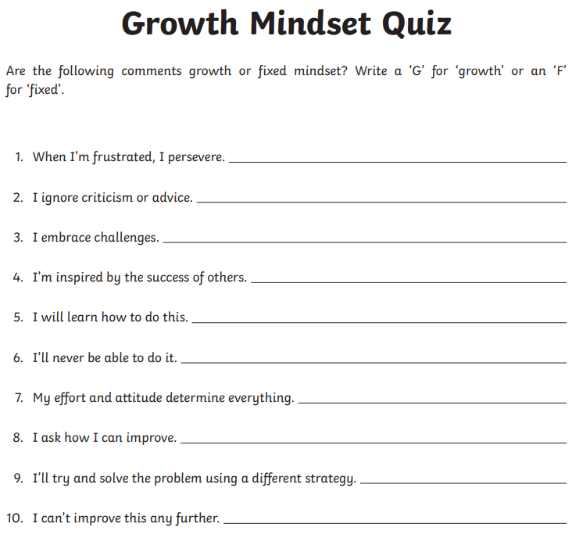

Slide 55
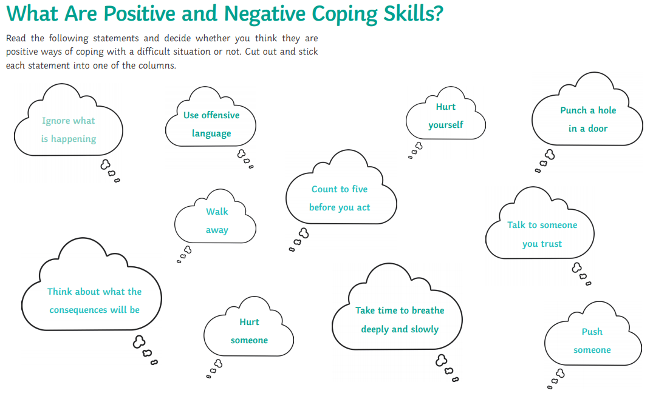

Slide 56
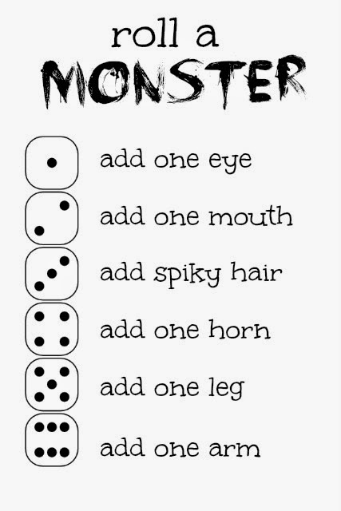

Slide 57
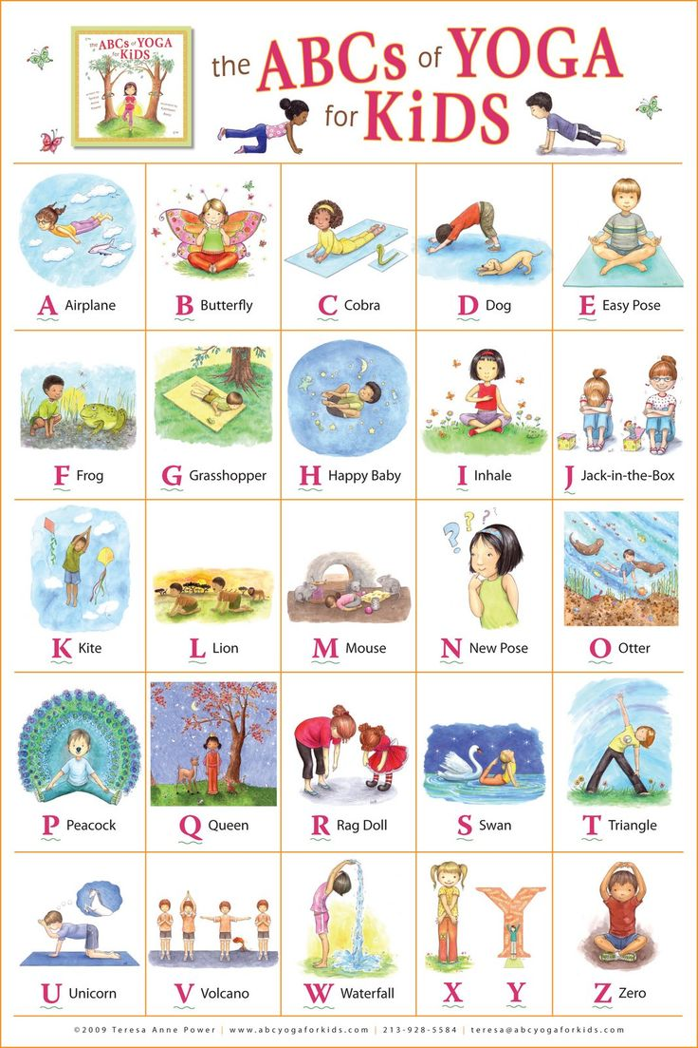

Slide 58
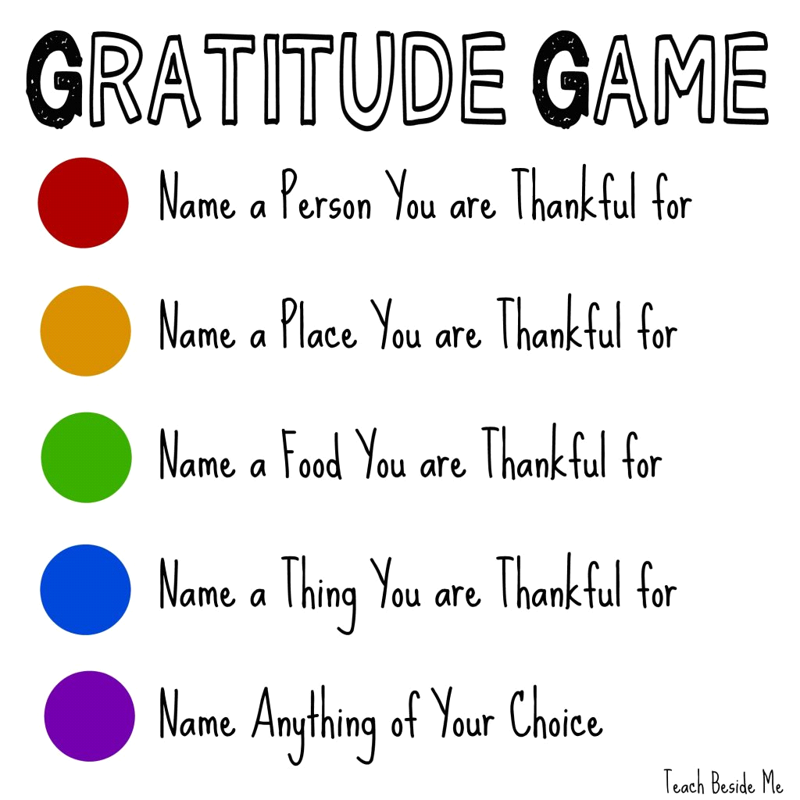

Slide 59
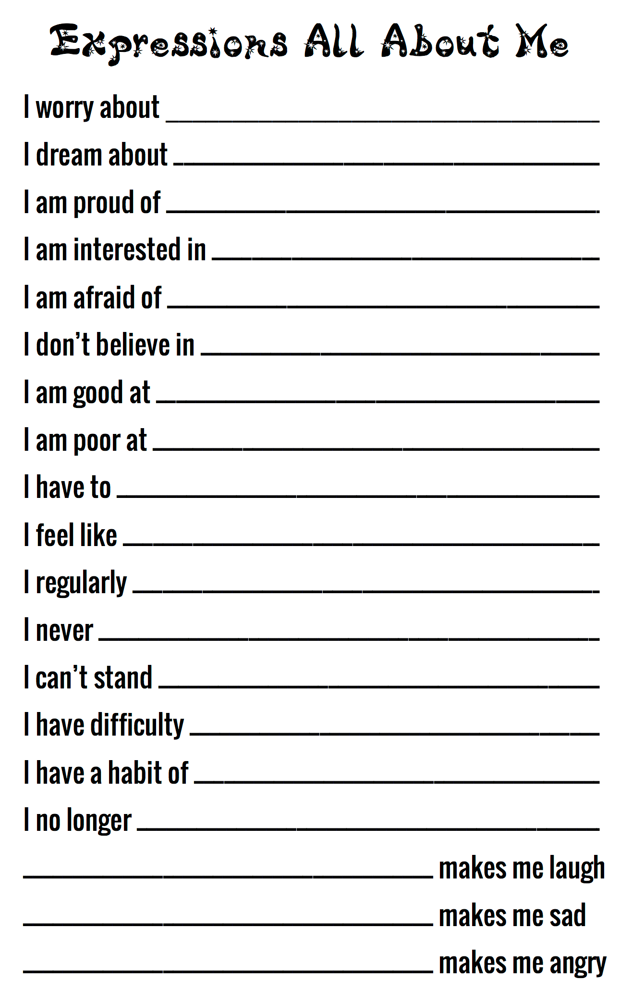

Slide 60


Slide 61


Slide 62


