Slide 1
Whilst You Are At Home
We are going to stay in touch
15th April 2020

Slide 2
Positive Message of the Week
Hello everyone, because we cannot visit you in your schools at the moment, we are now on our second weekly message. Each week we will be adding new activity ideas for you to do at home either by yourself, a family member or your personal friends online.
We are all aware of the changes going on at the moment which might make you feel scared or worried. That’s OK. It’s totally normal to feel like this. We all need to remember this situation won’t last forever.
At this difficult time some children will be spending more time online than ever before. They may be tempted to join groups, share pictures or participate in live streaming.

Slide 3
Police messages
Regarding Online safety
You are all smart children and we want you to remember the Online Safety message we sent. This is for the Adults to make sure they keep you safe.
Set up rules for using the computer and the internet.
Never let your child give out personal information.
Check The Websites and services the child uses.
Get to know your child’s online friends.
Keep the computer in a communal area of the house.
Check age ratings on games.
Twitter @CheshrieSSYP

Slide 4
https://www.o2.co.uk/help/nspcc/helpline

Slide 5
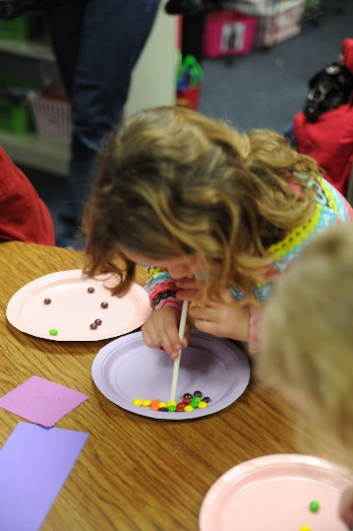
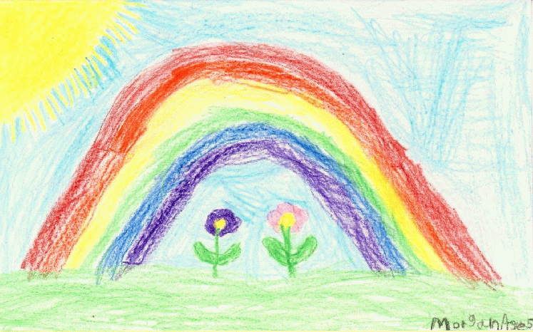
Activities
Riddle: “It goes up and down the stairs without moving?”
Answers on last slide, no peeking until you’ve had a go at this!
Don’t forget if you haven’t done a rainbow make one then place it in your window. Or try and draw any emergency vehicle.
Riddle: When is it bad to meet a white cat?”
Answers on last slide, no peeking until you’ve had a go at this!

Slide 6
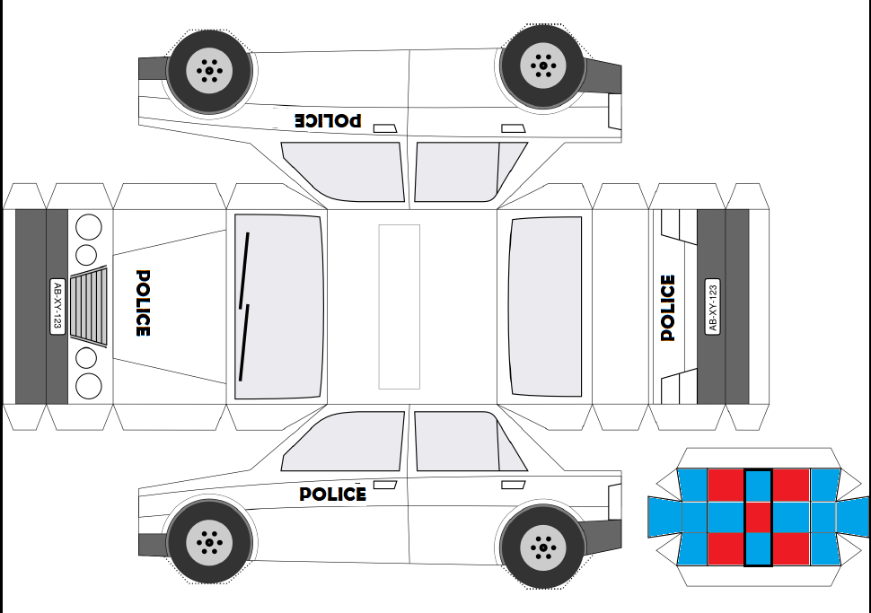

Slide 7
Until next Time
21st April 2020
Stay safe, by Washing your Hands and stay at home until it’s time for some exercise.
Stay healthy, by doing a bit of exercise every day.
Keep positive, by reminding yourself, You are an Amazing Child.
And remember we won’t be indoors forever
Childline | Childline
https://www.childline.org.uk
Get help and advice about a wide range of issues, call us on 0800 1111, talk to a counsellor online, send Childline an email or post on the message boards

Slide 8
Answers to Riddles “Riddle: It goes up and down the stairs without moving?” Answer: Carpet. Riddle: When is it bad luck to meet a white cat?” Answer: When you’re a mouse.

