Slide 1
All about Maths!

Slide 2
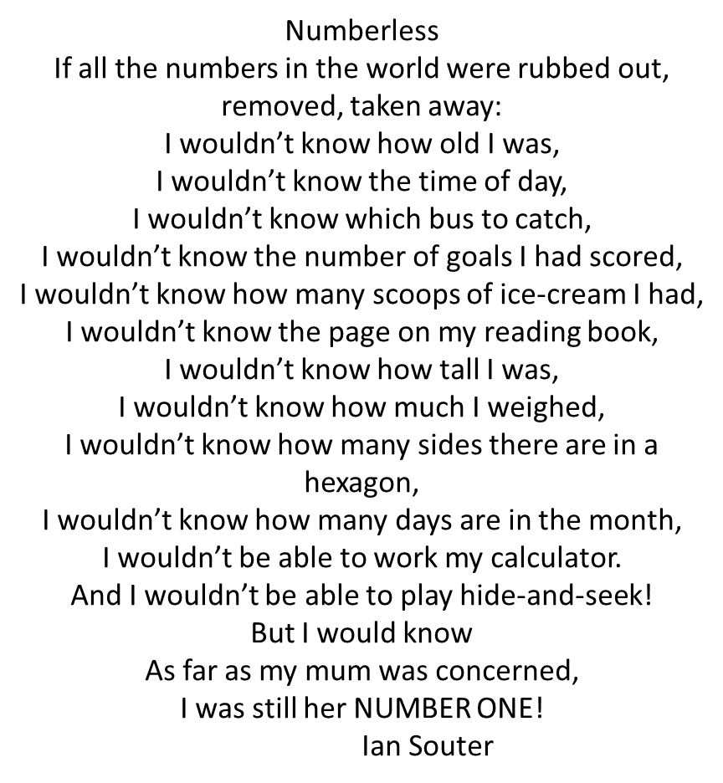

Slide 7
What is Mathematics Mastery?
Success for all pupils
Based on research and evidence
Problem solving is at the heart
Focus is on depth, not acceleration
Aligned to National Curriculum
Focus on talk and reasoning about mathematics

Slide 9
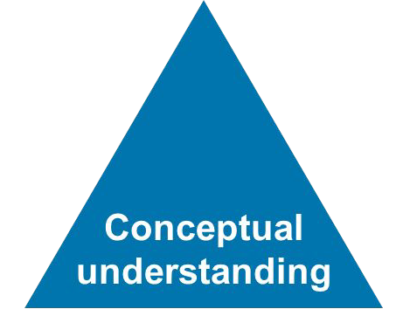
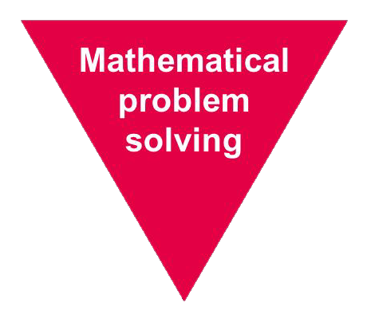
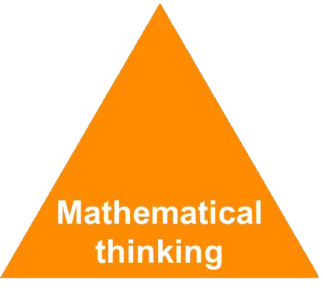
Depth Not Acceleration
What do we mean by depth?
How do we deepen understanding?

Slide 21
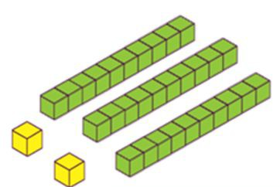
Conceptual Understanding
Representing a concept in different ways
Making connections between each way to deepen their understanding.
32

Slide 22
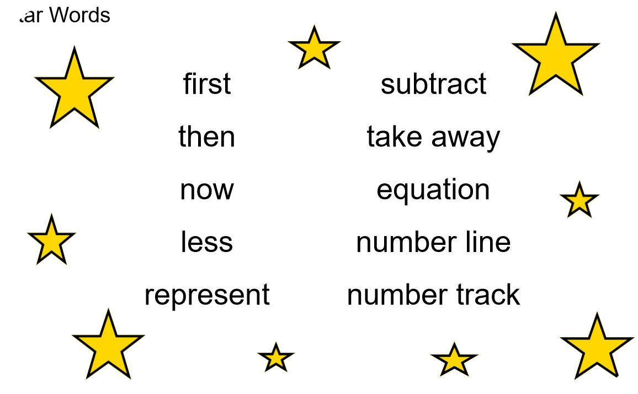
Language and Communication
Can you say that in a full sentence, please?

Slide 23
Mathematical Thinking
Do you think
… would always happen?
What’s the same? What’s different?
What do you think would happen if…?
What else could go in this set? What couldn’t?
Can you see a pattern? What would come next?
How do you know that?

Slide 24
Our Lesson Structure

Slide 32
On line Websites Sumdog TT Rockstars Century

