Slide 1
Whilst You Are At Home
We are going to stay in touch
Edition 8
26th May 2020

Slide 2
Positive messages of the week
Hello Everybody
We hope you are enjoying our weekly updates, we really miss seeing you and so it is nice to keep in touch. As you are aware everything that we do has a consequence, therefore we need you to really think about your safety. So from last week we have started sending a reminder of Road Safety and Safety whilst you are at home.
And remember Pc Panda wants you all to play your part in keeping safe!
We still enjoy seeing all your lovely rainbows.
Doing Our Bit for Great Britain the NHS and all key workers

Slide 3
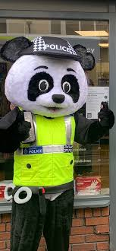
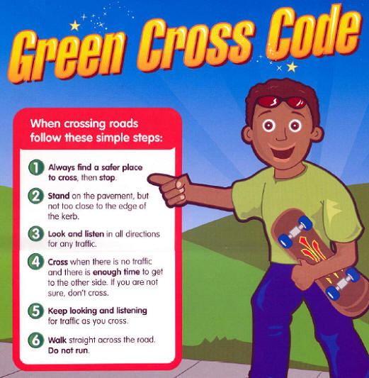
PC Panda, says
While, you are out getting some exercise, Don’t forget the

Slide 4
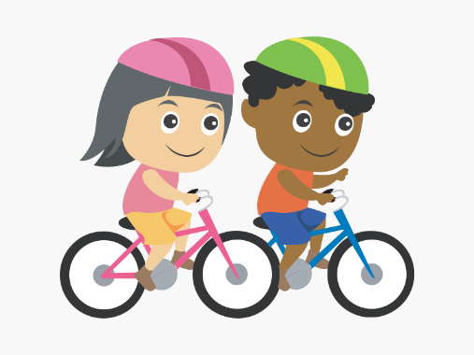
Pc Panda’s messages
When you are out on your bike
Always wear a helmet
Don’t listen to music whilst riding your bike
Be visible – wear bright clothing and have front and rear lights at night
Only one person on the bike at a time
Look after your bike and check it is safe every time you use it
Push your bike over roads and crossings
Get trained to use the roads properly
Don’t use your mobile phone whilst riding your bike

Slide 5
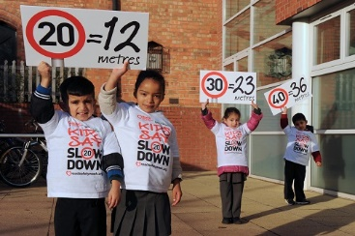
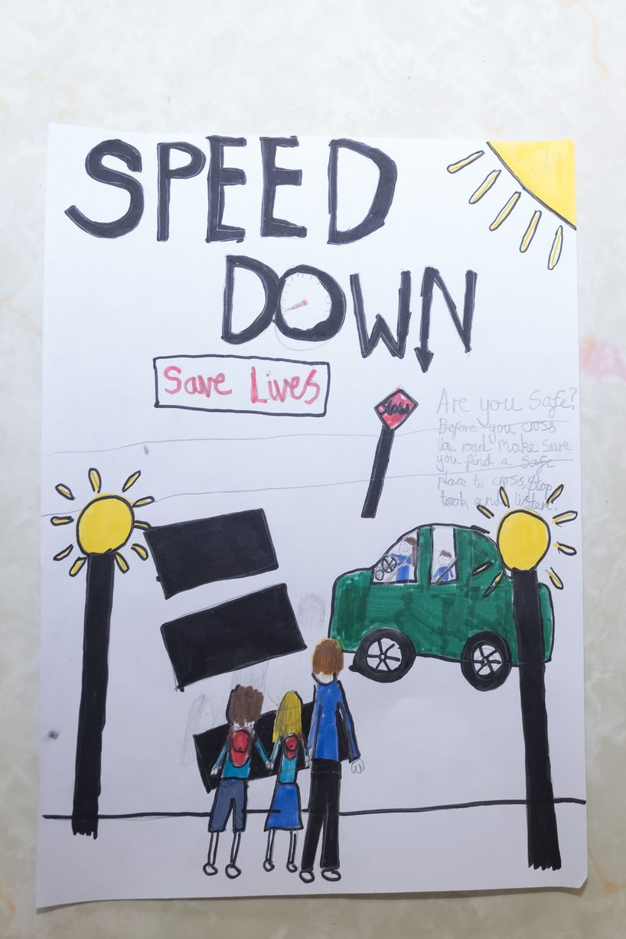
Here are Pc Panda’s speeding rules!
pDo

Slide 6
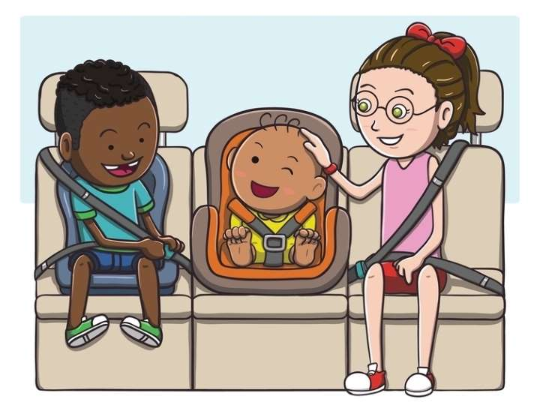
Being a responsible passenger in a car
Remember to first put on your seat belt, this will keep you safe. It is also the law.
And Don’t distract the driver. Allow them to concentrate on the road.

Slide 7
Pc Panda’s Messages about staying safe at home
NEVER tell anyone that you are home alone.
NEVER give any personal details away when answering the phone.
NEVER give your details to a stranger knocking on your door.
NEVER hide a key outside of your house (like under a plant pot)
NEVER answer the door to someone you don’t know.

Slide 8
If it is your Birthday this week Happy Birthday
Happy Birthday to you, Happy Birthday to you, Happy Birthday Special person Happy Birthday toooo yoooou

Slide 9
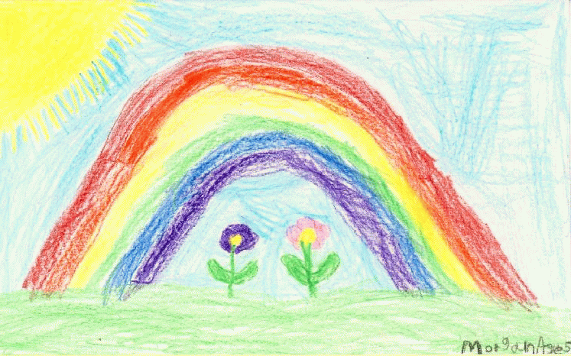
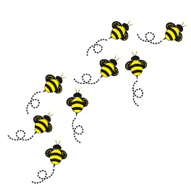
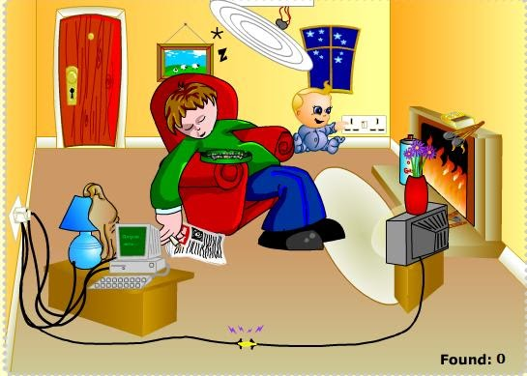
Busy Bees
Activity
Have a look at this picture and see how many hazards you can find?

Slide 10
Until next Time 2nd June 2020
Keep washing your hands and carry on with your exercise.
Stay healthy, by doing a bit of exercise every day.
Keep positive, by reminding yourself, You are an Amazing Child.
Do Your Bit for Great Britain and the NHS
Childline | Childline
https://www.childline.org.uk
Get help and advice about a wide range of issues, call us on 0800 1111, talk to a counsellor online, send Childline an email or post on the message boards

