Slide 1
Whilst You Are At Home
We are going to stay in touch
Edition 9
2nd June 2020

Slide 2
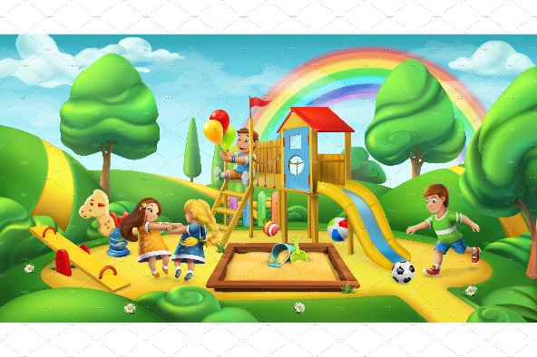
Positive messages of the week
Hello Everybody
Some of you will now be on Half term. We hope you are able to get outside and enjoy your local Parks and outdoor spaces. Last week we talked about Safety messages both while you are at home and when you are out and about. This week we are going to focus on Road Safety. As a Young person you can help keep our Roads safer!
Doing Our Bit for Great Britain, the NHS and all key workers

Slide 3
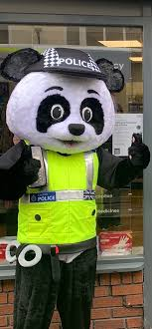
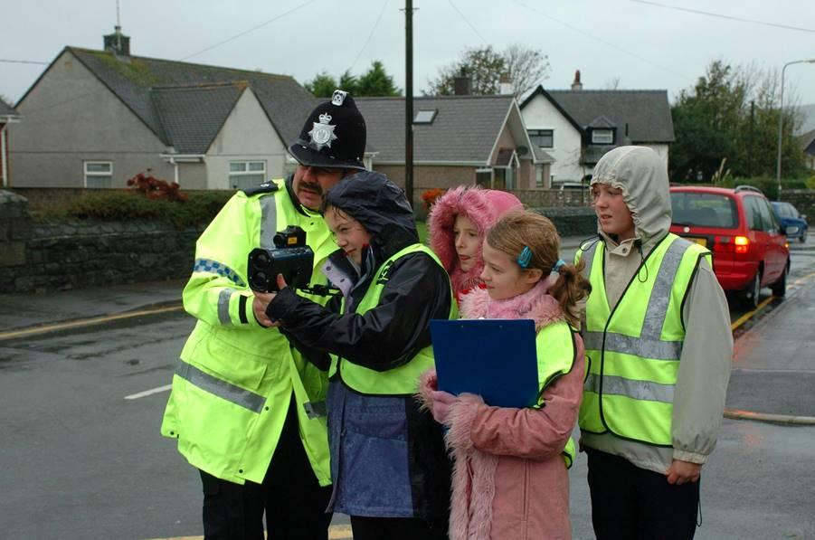
Pc Panda’s Traffic Advice
Pc Panda was told by your PCSO’s that many of you in the past have been out monitoring the speed of cars outside your schools, along with the Junior Safety Officers. Pc Panda would now like you to get involved with a Road Safety Poster! This will involve you creating a Poster to bring awareness to all drivers that can be displayed on your Wheelie bins when your parents put them out onto the street, you could also display them in your house windows and for those of you that are in School you could speak to your teacher about displaying them on the School gates. It would be very thoughtful if you said a Thank you to the bin men on your Poster too.

Slide 4
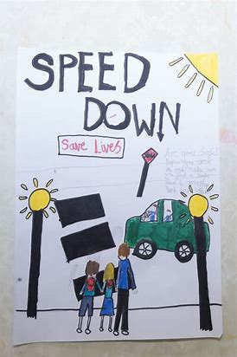
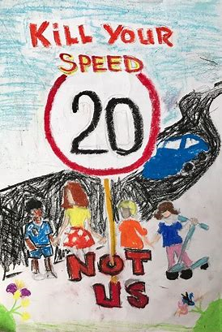
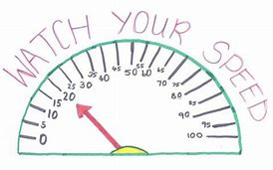
POSTER TIME
So we would like you to get creative and design your very own road safety poster. Also you could include a massive thumbs up to our bin men and put this on your poster or maybe make two.
Ask someone at home to help you display this on your wheelie bin or in your window. If you are at school, you could ask your teacher to display them on the school gates.
These pictures will put smiles on everyone’s faces and hopefully your local PCSO might see them and take a picture, we can then share them with everyone on these presentations.

Slide 5
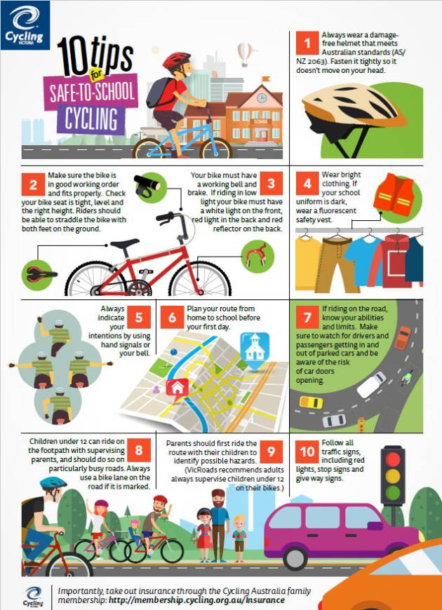

Slide 6
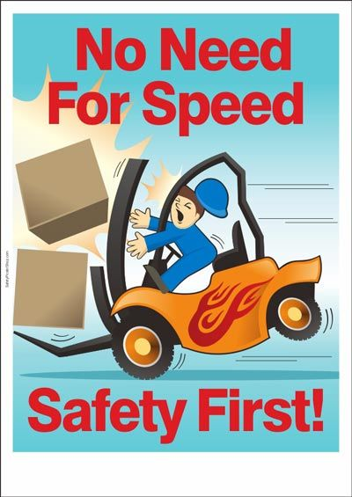
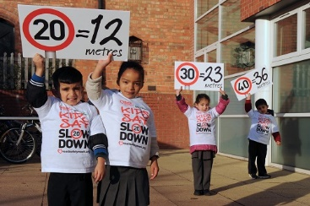
Here are Pc Panda’s speeding rules!
pDo

Slide 7
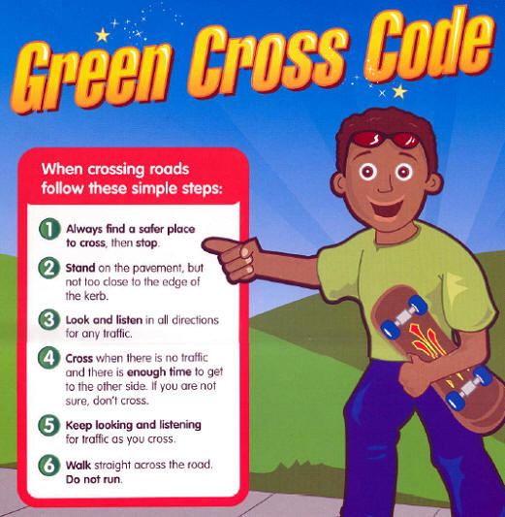
PC Panda, says
While, you are out getting some exercise, Don’t forget the

Slide 8
Pc Panda’s messages
When you are out on your bike
Always wear a helmet
Don’t listen to music whilst riding your bike
Be visible – wear bright clothing and have front and rear lights at night
Only one person on the bike at a time
Look after your bike and check it is safe every time you use it
Push your bike over roads and crossings
Get trained to use the roads properly
Don’t use your mobile phone whilst riding your bike

Slide 9
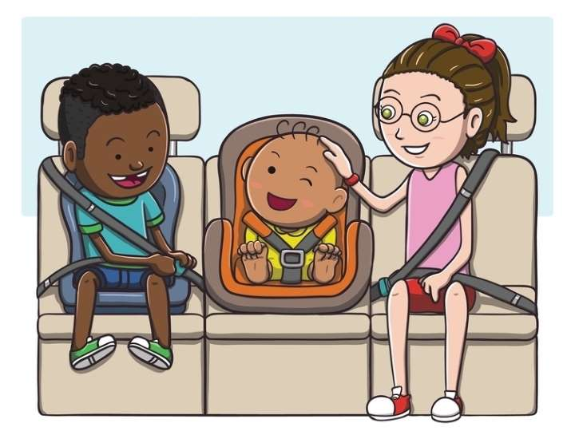
Being a responsible passenger in a car
Remember to first put on your seat belt, this will keep you safe. It is also the law.
And Don’t distract the driver. Allow them to concentrate on the road.

Slide 10
If it is your Birthday this week Happy Birthday
Happy Birthday to you, Happy Birthday to you, Happy Birthday Special person Happy Birthday toooo yoooou

Slide 11
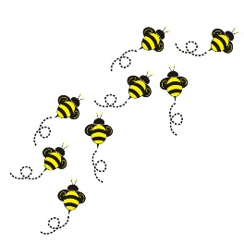
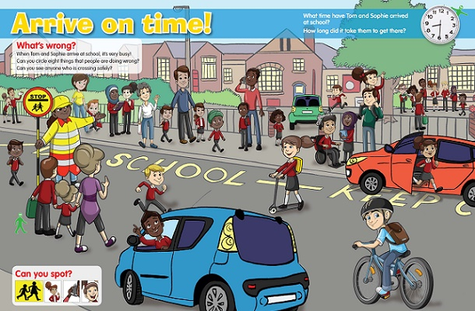
Busy Bees
Activity
Have a look at this picture and see how many hazards you can find?

Slide 12
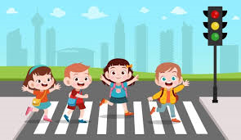
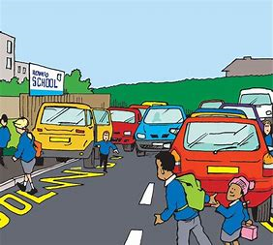
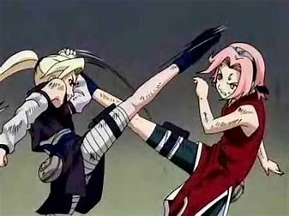
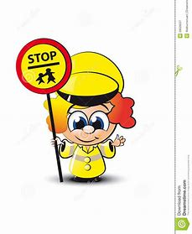
SAFETY FIRST GAME
2-4 players – Take turns; start at home, roll the dice and move across the footprints.
Stop on a question square you have 60 seconds to answer the question.
Answer Correct – move forward
Incorrect answer – go back 2 spaces
First person to reach the school WINS!
Good luck and have fun!
START
What is the Green Cross Code
What type of crossing is this?
What 2 hazards are in this picture?
What 2 things must you do when going on a safe journey?
You have been caught fighting, go back 10 spaces
Nearly there! Don’t forget to look left and right
You made it safely to school, congratulations

Slide 13
Until next Time 9th June 2020
Keep washing your hands and carry on with your exercise.
Stay healthy, by doing a bit of exercise every day.
Keep positive, by reminding yourself, You are an Amazing Child.
Do Your Bit for Great Britain and the NHS
Childline | Childline
https://www.childline.org.uk
Get help and advice about a wide range of issues, call us on 0800 1111, talk to a counsellor online, send Childline an email or post on the message boards
NSPCC Helpline 0808 800 5000

