Slide 2
Escape the Wind Tunnel
It is your brother’s 16th birthday. To celebrate, he has chosen to go indoor skydiving. Indoor skydiving is where people go inside a huge vertical wind tunnel. Gusts of wind, powerful enough to lift people off their feet, are blasted into the wind tunnel. It makes people look as if they have jumped from an aeroplane and are gliding through the sky.
Your brother dons his jumpsuit, helmet and goggles. Before the wind is turned on, you go in to wish him luck. Suddenly, you hear a deafening siren. A loud computerised voice says "Countdown initiated.” You turn around to see the door slam shut.
You rush to the door, hammer on it and call for someone to let you out. The computerised countdown continues…

Slide 3
Escape the Wind Tunnel
Your brother’s skydiving instructor appears on the other side of the door. “It’s sealed shut from your side,” she explains. “You need the code to get out,” she says, gesturing to the side.
You see a keypad next to the door. “I see it!” you shout. “What’s the code?” you ask desperately.
“I don’t know it,” answers the instructor. “But there are clues inside the tunnel. Find them and you can get out. But hurry! The countdown is on!” she warns.
Solve the clues and puzzles to discover the keypad code and escape the wind tunnel. The clues could be anywhere so you need to keep your eyes peeled and your mind sharp!

Slide 4
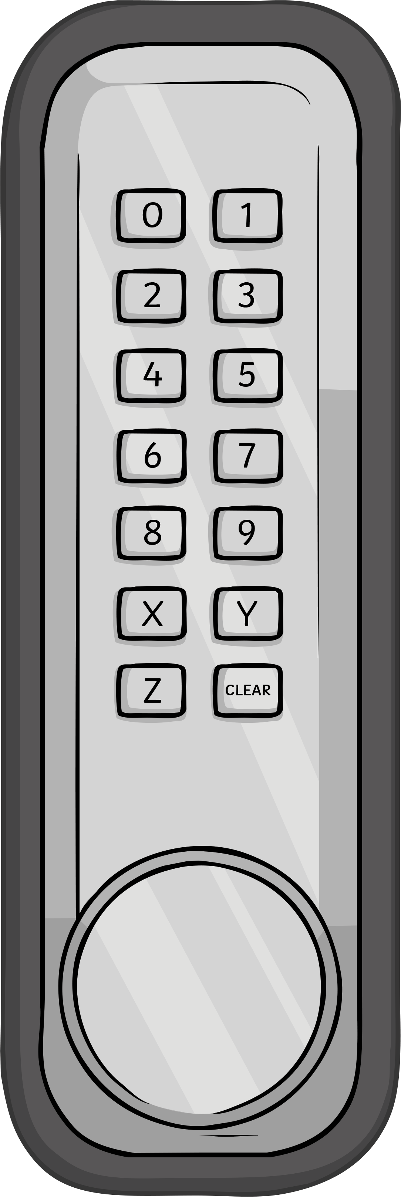
Escape the Wind Tunnel
The Rules
You can work in small groups.
When you find a clue, work together to solve the puzzle.
Write your answer down on your answer sheet.
Once you have discovered the number for the keypad, check it with your teacher to discover if you can escape the wind tunnel!

Slide 5
Escape the Wind Tunnel
Answers to the Clues

Slide 6
Escape the Wind Tunnel – Clue 1
Gravity is an invisible force that pulls everything towards the centre of Earth.
Class 5 did an experiment to test if objects with different masses fall at different speeds. They dropped objects of different masses from a height. They used a stopwatch to record how quickly each object fell to the ground.
Class 5 changed one variable, which was the mass of the objects.
The first digit on the keypad is one.
1

Slide 7
Escape the Wind Tunnel – Clue 2
The number of letters in the missing word is the second digit on the keypad.
Gravity is an invisible force that pulls objects towards each other.
The missing word is towards. It has seven letters.
The second digit on the keypad is seven.
7

Slide 8
Escape the Wind Tunnel – Clue 3
Read these statements.
Mass is a force.
Force is measured in Newtons.
Weight is a force.
Length is a force.
A force is a push or a pull.
Friction is a force which makes moving things go faster.
Upthrust is a type of friction.
False
True
True
False
True
False
False
There are three true statements.
The third digit on the keypad is three.
3

Slide 9
Escape the Wind Tunnel – Clue 4
Look at these forces.
balanced
unbalanced
A car
accelerating
A bike resting next to its rider
Someone sitting on a chair
Someone skydiving
There are two balanced forces.
The fourth digit on the keypad is two.
2

Slide 10
Escape the Wind Tunnel – Clue 5
Read the clues about forces and write the answer with one letter in each box.
The force when a magnet pulls towards a metal or another magnet.
m | a | g | n | e | t | i | s | m
The force that slows a moving object down.
f | r | i | c | t | i | o | n
The force that pulls Earth and other planets towards the Sun.
g | r | a | v | i | t | y
The scientist who discovered that gravity existed.
N | e | w | t | o | n
The force that acts upwards in a fluid.
u | p | t | h | r | u | s | t
i, t, g, e, h rearranged spells ‘eight’.
The fifth digit on the keypad is eight.
8

Slide 11
Escape the Wind Tunnel – Clue 6
Look at these pictures where friction is occurring.
Friction is useful to stop us slipping over when walking, to stop car tyres from skidding, when someone is climbing up a rope, to stop bike tyres from skidding.
The sixth digit on the keypad is four.
4

Slide 12
Escape the Wind Tunnel – Clue 7
Which lever will make lifting the block the easiest?
1
2
3
Lever 1 will make lifting the block easiest.
The seventh digit on the keypad is one.
1

Slide 13
Escape the Wind Tunnel – Clue 8
Which one of these statements best describes how turning a small gearwheel will affect the speed of a larger gearwheel?
1. The second gearwheel will turn more quickly than the first.
2. Both gearwheels will turn at the same speed.
3. The second gearwheel will turn more slowly than the first.
The second (bigger) gearwheel doesn’t have to move as quickly to keep up with the smaller gearwheel.
The eighth digit on the keypad is three.
3

Slide 14
Escape the Wind Tunnel – Clue 9
All these objects use either levers, pulleys or gears.
See-saws and bike brakes use levers. Flag poles and blinds use pulleys. Cranes, drills, pliers and clocks use gears.
The ninth digit on the keypad is four.
4

Slide 15
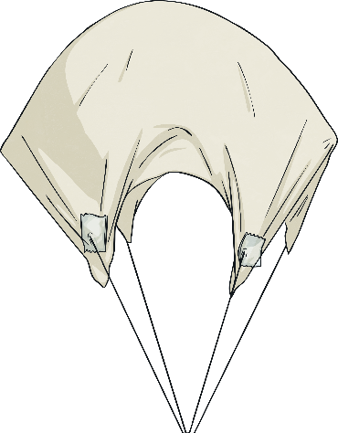
Escape the Wind Tunnel – Clue 10
Class 5 did an experiment to see whether the size of a parachute affects the speed in which it falls. They put their results into a table.
Size of Parachute (cm) | 1st Drop (seconds) | 2nd Drop (seconds) | 3rd Drop (seconds)
4 × 4 | 8.23 | 1.25 | 1.29
8 × 8 | 2.5 | 2.66 | 5.08
16 × 16 | 3.32 | 1.56 | 3.4
32 × 32 | 4.41 | 7.43 | 4.58
There are four results that look like anomalies.
The tenth digit on the keypad is four.
4

Slide 16
Escape the Wind Tunnel
Now you’ve solved all the clues, it’s time to enter the code into the keypad and escape the wind tunnel!
Digit 1
Digit 2
Digit 3
Digit 4
Digit 5
Digit 6
Digit 7
Digit 8
Digit 9
Digit 10
?
?
?
?
?
?
?
?
?
?
1
7
3
2
8
4
1
3
4
4
unlock

