Slide 2
Diving into Mastery Guidance for Educators
Each activity sheet is split into three sections, diving, deeper and deepest, which are represented by the following icons:
These carefully designed activities take your children through a learning journey, initially ensuring they are fluent with the key concept being taught; then applying this to a range of reasoning and problem-solving activities.
These sheets might not necessarily be used in a linear way. Some children might begin at the ‘Deeper’ section and in fact, others may ‘dive straight in’ to the ‘Deepest’ section if they have already mastered the skill and are applying this to show their depth of understanding.
Diving
Deeper
Deepest

Slide 3
Aim
Divide numbers up to 4 digits by a two-digit whole number using the formal written method of long division, and interpret remainders as whole number remainders, fractions, or by rounding, as appropriate for the context.

Slide 4
Long Division 4
Diving
Use your knowledge of multiples to help you solve these division questions:
2564 ÷ 22 =
116r12
1178 ÷ 21 =
56r2
0
1
1
6
r12
0
0
5
6
r2
2
2
2
5
6
4
2
1
1
1
7
8
−
2
2
−
1
0
5
3
6
1
2
8
−
2
2
−
1
2
6
1
4
4
2
1
3
2
1
2

Slide 5
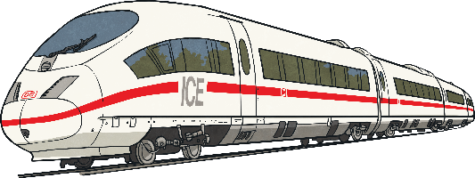
Long Division 4
Diving
Solve these division word problems.
A train is able to fit 65 passengers into each carriage. How many carriages will the train need in order to carry 1428 passengers?
0
0
2
1
r63
6
5
1
4
2
8
The train will need to have 22 carriages.
21 carriages will be full and the last will have 63 passengers on board.
−
1
3
0
1
2
8
−
6
5
6
3
A factory can pack 38 jars into a box. There are 3498 jars to pack. How many boxes can they fill with jars? How many will be left over?
0
0
9
2
r2
3
8
3
4
9
8
−
3
4
2
92 boxes will be filled with 2 jars left over.
7
8
−
7
6
2

Slide 6
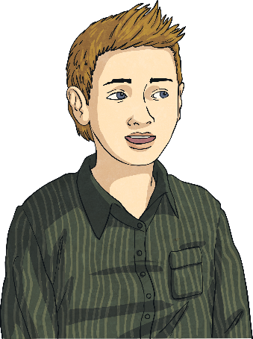
Long Division 4
Deeper
Two children have been asked to solve this problem: 3390 ÷ 15
Ben
I don’t think there will be a remainder because 3390 is a multiple of 30 and it will therefore be a multiple of 15.
Devinder
I don’t think there will be a remainder because 3390 is divisible by 3 and 5, which are both factors of 15.
Both boys are correct. Ben is correct because 3390 will divide by 30 and not leave a remainder. As 15 is a factor of 30, 3390 will not leave a remainder when divided by 15. Devinder is correct because 3390 is divisible by 3 and 5, and because they are prime factors of 15, 3390 will not leave a remainder when divided by 15.

Slide 7
Long Division 4
Deeper
Use these division calculations to decide if the statements are always, sometimes or never true. Explain your reasoning.
If the dividend is a multiple of 5 and the divisor is a multiple of 5, there will be no remainder.
If the dividend is odd and the divisor is odd, there will not be a remainder.
Sometimes true. In 1950 ÷ 25, both numbers are multiples of 5 and there is no remainder left. However, in 1855 ÷ 15, both numbers are multiples of 5 but a remainder is left.
Sometimes true. In 1015 ÷ 35, both numbers are odd and there is no remainder. In 1855 ÷ 15, both numbers are odd but there is a remainder of 10.
1855 ÷ 15 =
1015 ÷ 35 =
1950 ÷ 25 =
123r10
29
78

Slide 8
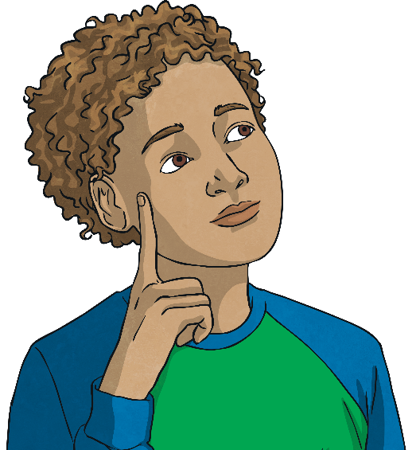
Long Division 4
Deepest
Choose a four-digit number from the numbers below.
1632 is a multiple of 2, 3 and 24.
2808 | 1872
is a multiple of 2, 3, 9, 18 and 24.
is a multiple of 3, 9, 18 and 24.
Which divisors from the table will not leave a remainder when you divide your number by them? Prove it.
For example:
1632 ÷ 9 = 181r3
1632 ÷ 2 = 816
1632 ÷ 3 = 544
1632 ÷ 28 = 58r8
1632 ÷ 18 = 90r12
1632 ÷ 24 = 68
One-Digit Divisor | Two-Digit Divisor
9 | 28
2 | 18
3 | 24

Slide 9
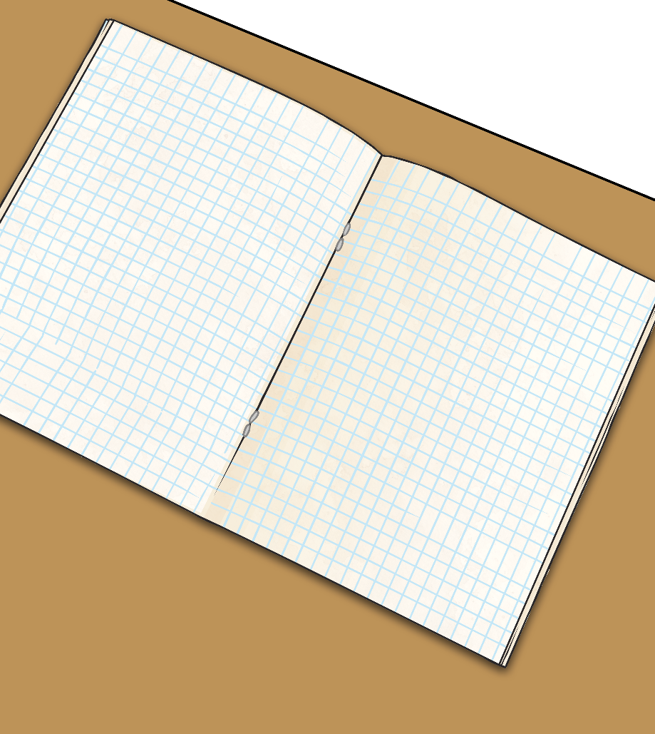
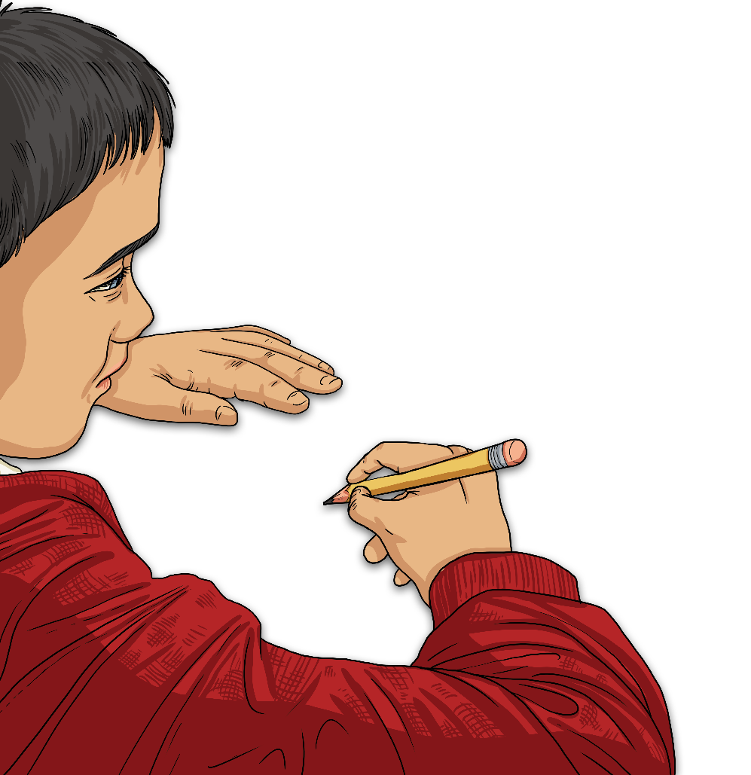
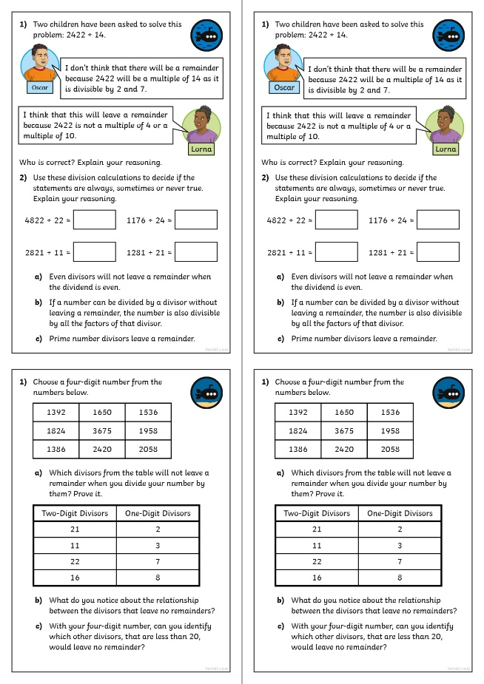
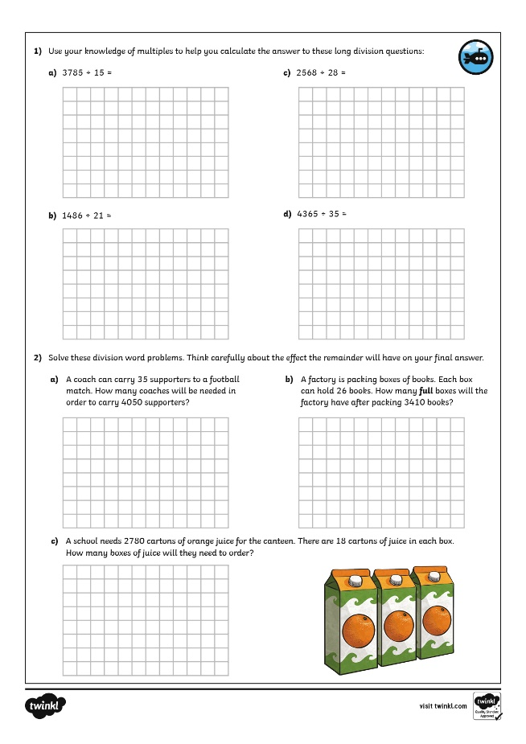
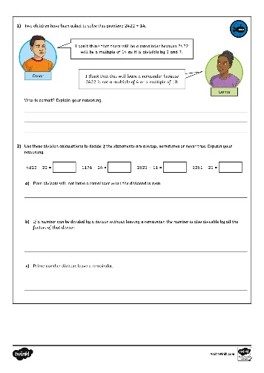
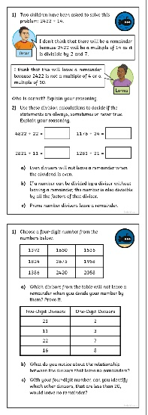
Long Division 4
Dive in by completing your own activity!

Slide 10
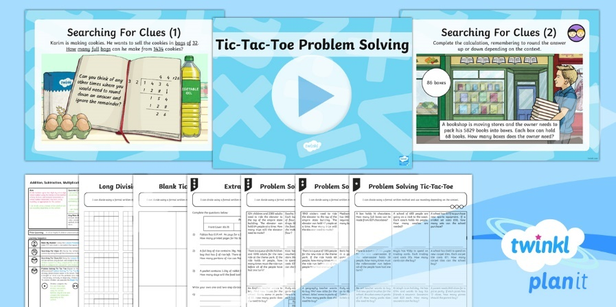
Need Planning to Complement this Resource?
National Curriculum Aim
Divide numbers up to 4 digits by a two-digit whole number using the formal written method of long division, and interpret remainders as whole number remainders, fractions, or by rounding, as appropriate for the context.
For more planning resources to support this aim, click here.
Twinkl PlanIt is our award-winning scheme of work with over 4000 resources.

